Slide 1


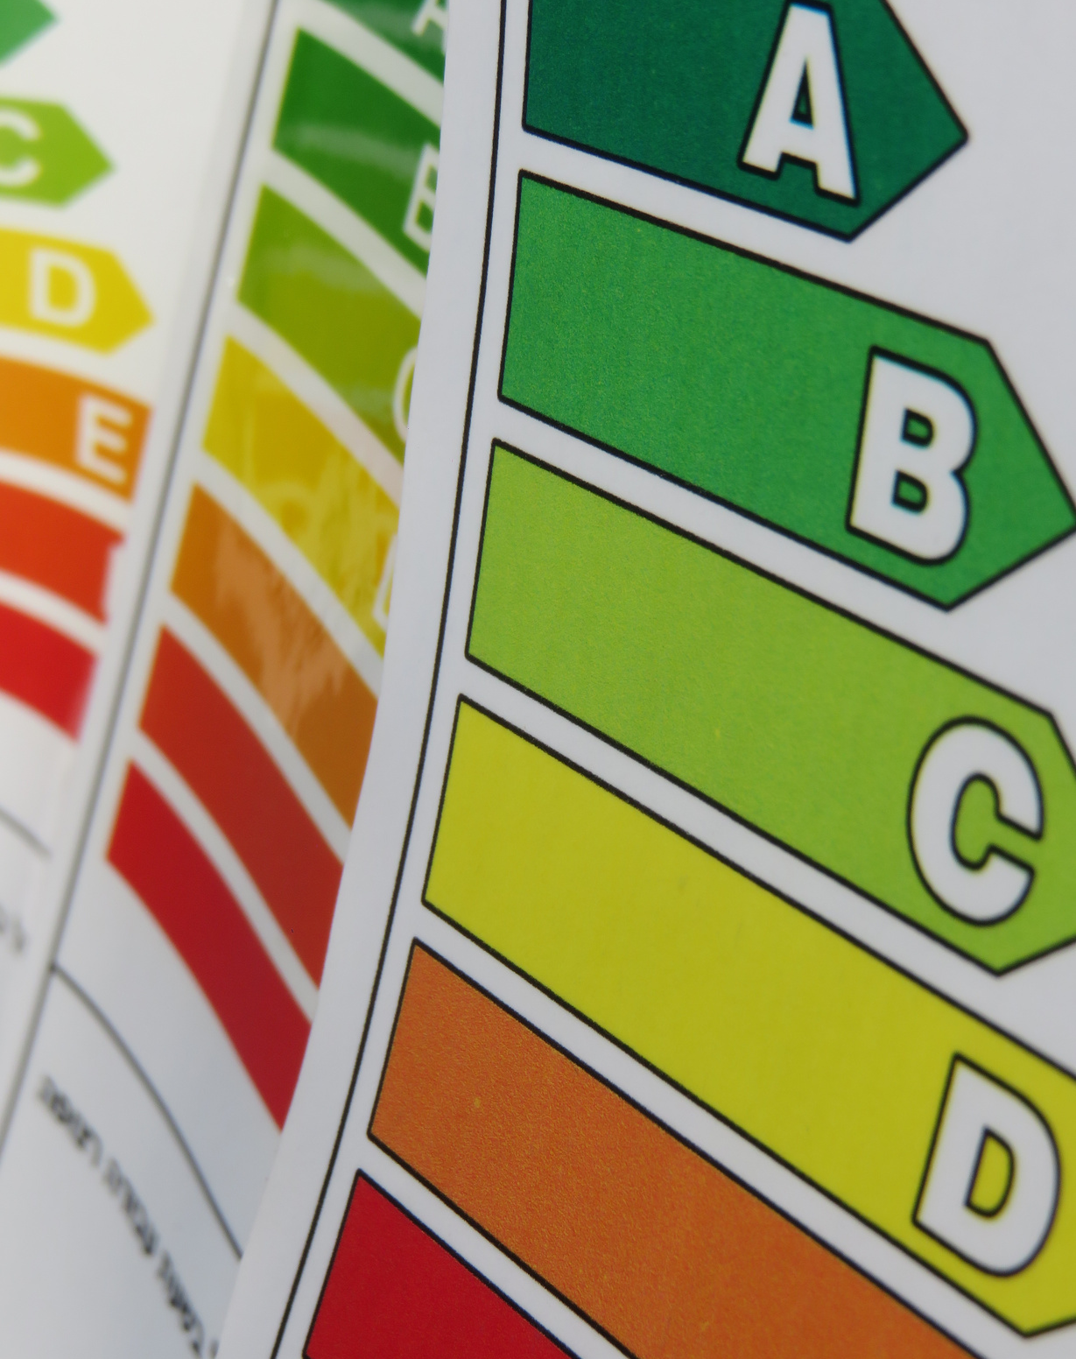

EnergyEfficiency4SMEs
Co-Funded by the European Union
ENERGY EFFICIENCY IN ACTION:
Equipping SMEs for a Green Transition
16 October 2025
www.ee4sme.com

Slide 2


EnergyEfficiency4SMEs
Co-Funded by the European Union
Welcome Coffee and Registration

Slide 3

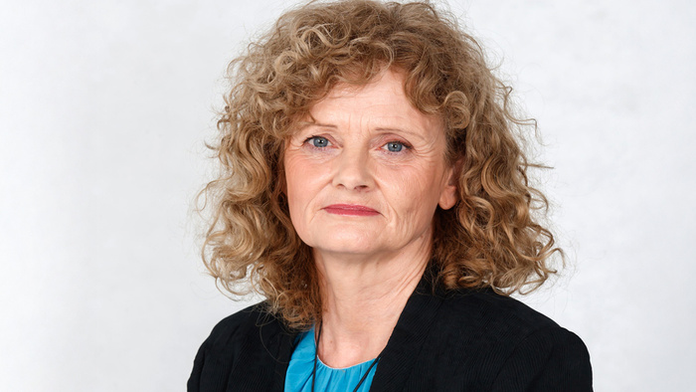
EnergyEfficiency4SMEs
Co-Funded by the European Union
Opening remarks
Antonija Božič Cerar
Eurochambres Sustainability Committee Chair & Director of the Department for environment, climate and energy – CCI Slovenia

Slide 4
EnergyEfficiency4SMEs
Co-Funded by the European Union
From Audits to Action: Results and Implementation of Energy Efficiency Measures

Slide 5
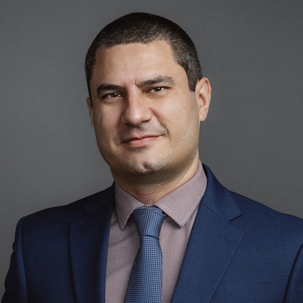


EnergyEfficiency4SMEs
Co-Funded by the European Union
Speakers
Antoine Fenech
Ziheng Song
Audrey Pujol
Partner at Deloitte Malta Audit and Assurance practice
Senior Consultant at Deloitte Malta
Economic Studies Officer at CCI Nice Côte d'Azur

Slide 6
EnergyEfficiency4SMEs
Co-Funded by the European Union
ENERGY EFFICIENCY IN ACTION:
Equipping SMEs for a Green Transition
EE4SMEs Audits report

Slide 7



EnergyEfficiency4SMEs
Co-Funded by the European Union
The EE4SMEs follow-up study delivers a comprehensive assessment to guide policy directions
Examine Energy Efficiency Measures (EEMs)
Contextual Analysis of Energy Landscape
Evaluate and Prioritse Socio-Economic Impact
The following sections present selected aspects of the study, including:
The number of audits received
Key attributes of EEMs
Identified NEBs
The full report can be accessed via (link)
EEMs collected from project partners were thoroughly analysed to identify:
Their funding sources
Implementation barriers
Key attributes
Adoption patterns
Explored the socio-economic benefits of energy savings
Analysed energy production methods and trend in partner countries
Evaluated both the external environmental costs and the current and projected costs of different production methods
Identified and assessed the non-energy benefits (NEBs) and non-energy efforts (NEEs) of the EEMs, drawing on the KNOWnNEBs project and literature review, and developed methodologies to quantify them where feasible, including conversion into monetary terms.

Slide 8
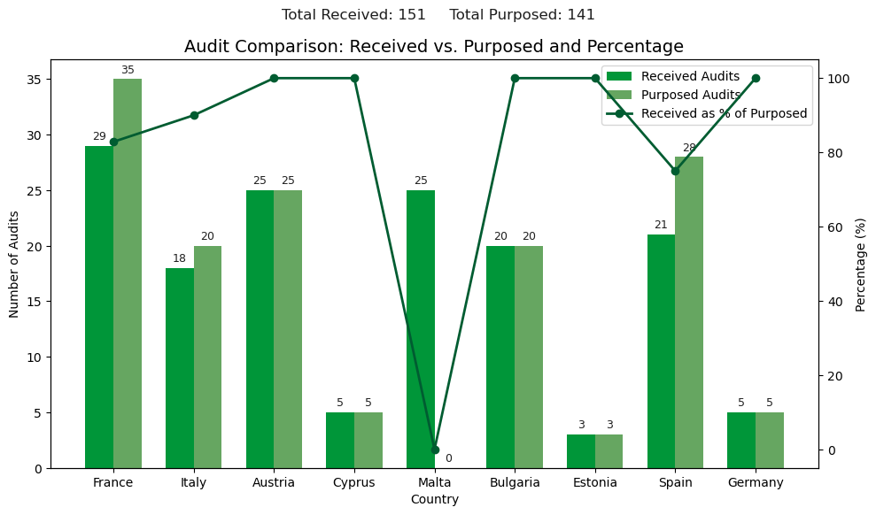
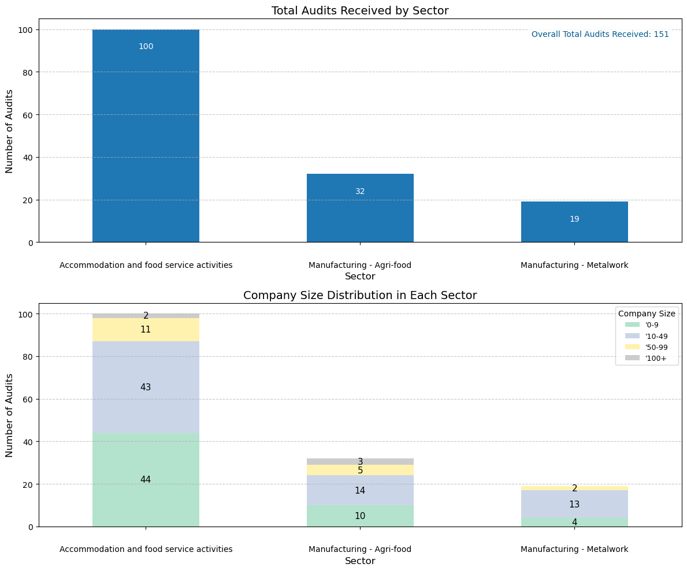
EnergyEfficiency4SMEs
Co-Funded by the European Union
151 Energy Audits Delivered vs. 141 Planned (+7.1%)
Austria, Cyprus, Bulgaria, Estonia & Germany achieved 100% of planned audits
Malta contributed 25 additional audits (no assigned target).
Main sectors audited: Accommodation & food services, followed by agri-food manufacturing.
Company size focus: Micro (0-9 employees) and Small (10-49 employees) enterprises.
Notes:
Say:
Beyond the audits themselves, energy auditors provided tailored recommendations for energy efficiency measures, together with key economic indicators and estimates of energy and carbon savings.
The following slides present further details on these recommended measures, including a deeper assessment of their technical and financial viability as well as their expected environmental impacts. The current analysis is based on the data available at the time of completing this study; since then, updated data has been collected and further insights have been generated by the project partners, which will be presented in later sections.

Slide 9
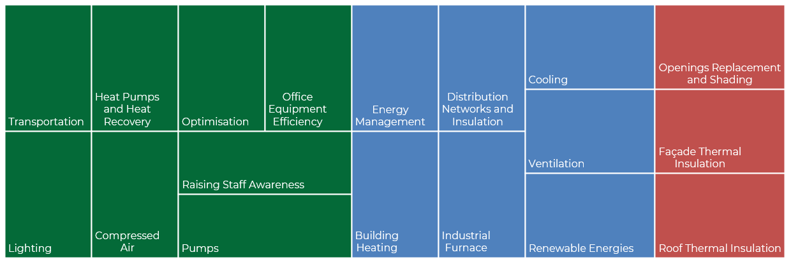
EnergyEfficiency4SMEs
Co-Funded by the European Union
Operational and equipment-focused measures score high on technical feasibility
Energy Efficiency Measures (EEMs)
Technical Feasibilities
High
Medium
Low
Lighting
Building Heating
Renewable Energies
Heat Pumps and Heat Recovery
Compressed Air
Ventilation
Cooling
Energy Management
Office Space (e.g., Equipment)
Façade Thermal Insulation
Roof Thermal Insulation
Openings Replacement and Shading
Industrial Furnaces
Distribution Networks and Insulation
Pumps
Optimisation
Raising Staff Awareness
Transportation
Technical feasibility is assessed based on three factors: installation complexity, compatibility with existing infrastructure, and maintenance requirements.
Each factor is scored, and the results are combined into an overall feasibility score.
This method is intended for high-level comparative analysis where direct feasibility data is unavailable, and should not be applied to site-specific assessments.
Notes:
Say:
To ensure the analysis reflects real-world implementation, the attributes of each measure were drawn, where applicable, from both the energy audits (WP3) and the performance surveys (WP8). Because these two sources use different naming conventions to describe similar measures, a standardisation process was carried out to create a harmonised list that could be used consistently for analysis.

Slide 10
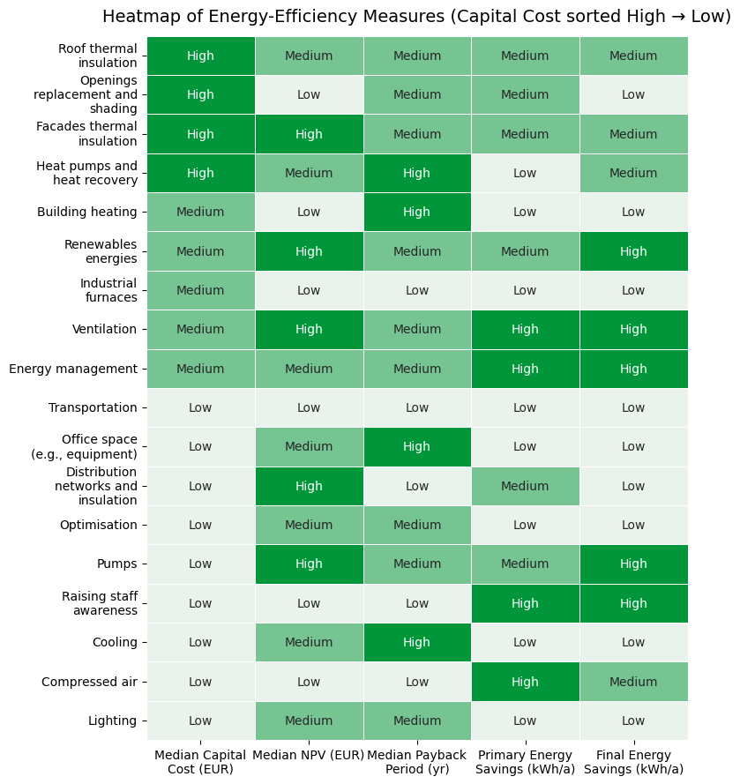
EnergyEfficiency4SMEs
Co-Funded by the European Union
Low-cost measures, mainly in operations and equipment upgrades, dominate
Economic Viability
High-capital measures are dominated by building fabric and HVAC system improvements. Low-capital measures are dominated by operational tweaks, equipment optimisation, and awareness campaigns.
Due to data limitations, these result should be interpreted as directional, not definitive.
Quick win measures: raising staff awareness, compressed air, and pumps.
Strategic Investments: facade thermal insulation, renewables energies, ventilation, and energy management.

Slide 11
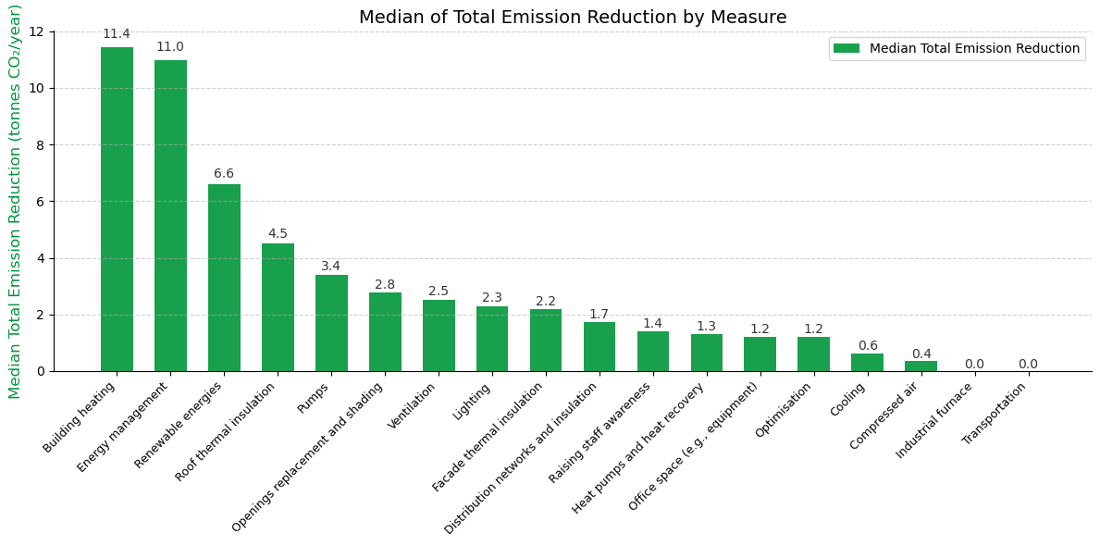
EnergyEfficiency4SMEs
Co-Funded by the European Union
Heating, energy management, and renewables drive the largest emission cuts
Environmental Impact
Building heating, energy management, and renewable energy installations deliver the largest median emission reductions.
Cooling, compressed air systems, office space equipment, and optimisation achieve only modest reductions (≤1.2 tCO₂/year each) when assessed individually.
Due to data limitations, these result should be interpreted as directional, not definitive.

Slide 12
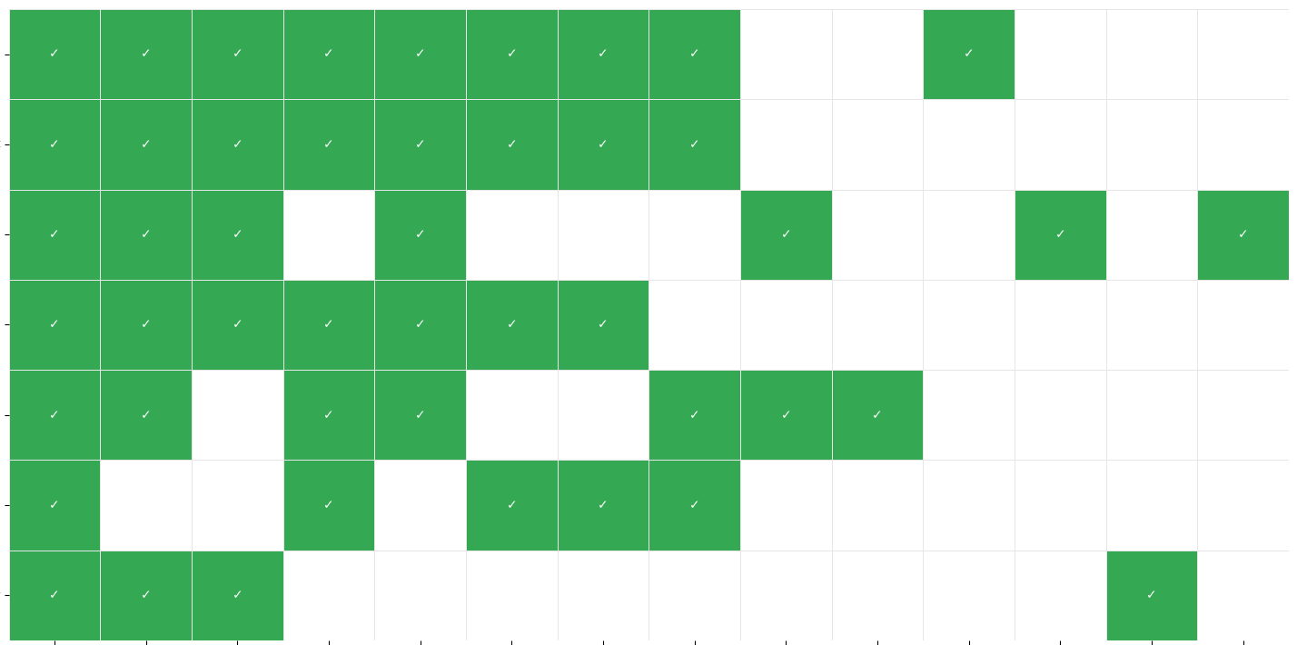
EnergyEfficiency4SMEs
Co-Funded by the European Union
Integrating NEBs into EEM evaluations is critical to capturing their full value.
NEBs (Non Energy Benefits)
Renewable energies
Quantified
Energy management
Directly translated into financial terms.
Examples:
Reduced machine downtime – higher production
Avoided regulatory fines through better emissions control
Raising staff awareness
Pumps
Ventilation
Façade thermal insulation
Non-Quantified
Compressed air
Not easily expressed in monetary values, but still valuable.
Examples:
Better employee comfort (thermal, ventilation)
Safer workplace and reduced hazards
1
2
3
4
5
6
7
8
9
10
11
12
13
14
Emission reduction
Reduced emissions (dust, CO2, Chemical agents, etc.)
Improvement of competitiveness
Increased real estate value
Reduction of emission or disposal fees
Energy security
7. Reduced use of non-renewable resources
8. Employee satisfaction
Improved air quality
Increased corporate image
Increased productivity
Reduction of costs
Reduction of operating costs
Note: NEBs of the EEMs were identified using Tool 1 (Identification of NEBs) from the KNOWnNEBs project

Slide 13
EnergyEfficiency4SMEs
Co-Funded by the European Union
ENERGY EFFICIENCY IN ACTION:
Equipping SMEs for a Green Transition
EE4SMEs Implementation Report
www.ee4sme.com

Slide 14


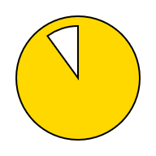
EnergyEfficiency4SMEs
Co-Funded by the European Union
The EE4SMEs WP4 and WP8: both entries to study implemented energy efficiency measures
Key figures of Energy Efficiency Measures (EEMs)
Closer look at the SMEs that have answered WP8 survey
Focus on the investments, as well as possible obstacles
EEMs collected from project partners were studied to identify:
State of implementation.
Breakdown of EEMs by sector.
Breakdown of EEMs by country.
Type of firms having implemented EEMs (focus on audited and trained ones).
Breakdown by sector.
Main types of EEMs implemented.
Breakdown of investments made by company size.
Breakdown of investments by EEMs types.
Main obstacles mentioned as a reason not to have implemented/invested in EEMs.

Slide 15
EnergyEfficiency4SMEs
Co-Funded by the European Union
WP4
Energy Efficiency Measures

Slide 16
EnergyEfficiency4SMEs
Co-Funded by the European Union
More than 1 000 Energy Efficiency Measures highlighted
Key figures regarding EEMs in the project
Total number of EEMs implemented: 423
Total number of ongoing EEMs: 241
Total number of yet to be implemented EEMs: 206
Other: 134
Accommodation and food services concentrate half the number of EEMs highlighted during the project.
On the contrary, based on the primary results, Agrifood manufacturing concentrates the lesser part (around 10 % of EEMs).

Slide 17
EnergyEfficiency4SMEs
Co-Funded by the European Union
More than 1 000 Energy Efficiency Measures highlighted
France, Italy and Malta showcase 75 % of the EEMs studied.
Accommodation and food services is the sector with the higher number of EEMs while, in proportion, 40 % of EEMs of the Manufacturing Metal Work industry are implemented.
Due to analysis still being conducted, all these results should be handled with care.
Notes:
The variation across countries mainly reflects differences in policy frameworks, industrial profiles, financial incentives, and levels of awareness. France and Italy lead due to strong regulatory support and mature energy efficiency programs, while other countries are still developing their national frameworks or have smaller markets for EEM implementation.
It would also be interesting to analyze the average or median number of measures implemented per company in each country to better understand whether the high shares (like in France and Italy) result from a large number of active companies or from a few firms implementing many measures.

Slide 18
EnergyEfficiency4SMEs
Co-Funded by the European Union
WP8 Evaluation Survey Answers

Slide 19
EnergyEfficiency4SMEs
Co-Funded by the European Union
A closer look at SMEs which were part of the project and answered the survey
Audited SMEs
Trained SMEs
78 % of audited firms (and having answered the survey) declared that they implemented energy efficiency measures over the past year.
Main sector for audited firms having implemented EEMs: Accommodation & food services (81 %).
Median number of employees for firms having implemented measures: 11 employees.
A percentage that is 90 % for those who were trained as part of the project.
Main sector for trained firms having implemented EEMs: Accommodation & food services (79 %).
Median number of employees for firms having implemented measures: 12 employees.
Notes:
Base réponses pour Audit : 106 dont 83 avec EEMs
Base réponses pour Trained : 58 dont 52 avec EEMs

Slide 20
EnergyEfficiency4SMEs
Co-Funded by the European Union
Top 3 of EEMs implemented by SMEs over the past 12 months
Energy Efficiency Measures (EEMs)
SMEs
Lighting
Building Heating
Renewable Energies
Heat Pumps and Heat Recovery
Compressed Air
Ventilation
Cooling
Energy Management
Office Space (e.g., Equipment)
Industrial Furnaces
Distribution Networks and Insulation
Pumps
Optimisation
Raising Staff Awareness
Transportation
Raising staff awareness (17 %)
Energy management (15 %)
1
Lighting (14 %)
2
3
For the firms having implemented EEMs over the past 12 months, the most represented ones are: Raising staff awareness, Energy management, and Lighting.
Based on the WP8 Evaluation Survey #3, specifically among audited and trained firms, more than 400 EEMs were implemented over the past 12 months.
Among other types of EEMs implemented by the SMEs, are highlighted: Renewable energies, Distribution networks & insulation, and Cooling.
Notes:
When we talk about Energy Management, we are talking about
Energy Management (automated systems and data analysis tools to monitor, control, and optimise energy use)

Slide 21
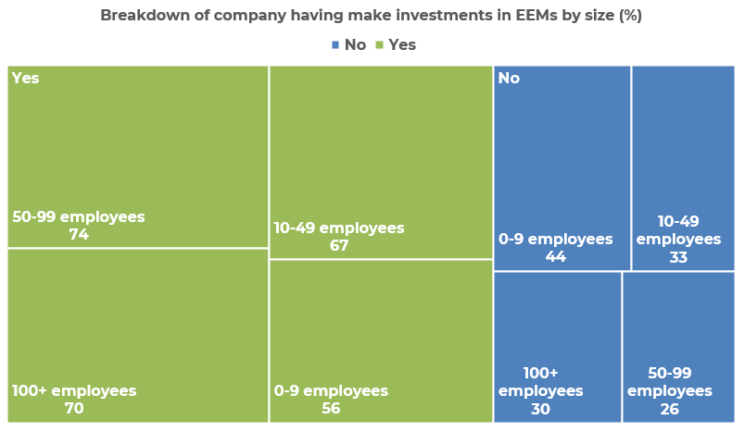
EnergyEfficiency4SMEs
Co-Funded by the European Union
Focus on the main investments made by the SMEs
A clear majority in all size categories have made investments, with larger firms (50–99 and 100+ employees) showing the highest rates at 74 % and 70 %.
Mid-sized companies (10–49 employees) also show strong participation at 67 %, while smaller firms (0–9 employees) are lower at 56 %.
Overall, investments in EEMs tend to increase with company size, suggesting that larger firms have greater capacity and resources to implement such measures.
Have you make any investments to improve your energy efficiency over the last 12 months?
Notes:
The first chart shows the financial investments made over the past 12 months. It highlights that most funding went into energy management (18%), lighting (16%), and renewable energies (15%).
The second chart, however, illustrates the number of measures implemented during the same period — not the amount of money spent.
👉 Therefore, while the largest financial investments were directed toward energy systems and equipment, the highest number of concrete actions focused on raising staff awareness (17%).
Why isn’t there a perfect correlation between investment levels and the number of measures? → It may reflect differences in cost per action, priorities, or ease of implementation.
Renewable energy production (kWh): 934 506
Investments made into renewable energies (€): 3 220 791
Upcoming investments to be made in renewable energies (€): 6 308 799

Slide 22
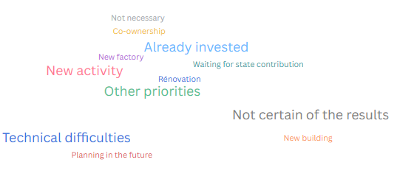
EnergyEfficiency4SMEs
Co-Funded by the European Union
Main obstacles identified to the implementation/investments in EEMs
Other reasons why companies have not invested in energy efficiency
Among other types of reasons advanced by the SMEs: Technical difficulties, Other priorities, Co-ownership are being mentioned by the firms.
However, it should be noted that 76 % of companies plan to implement EEMs within the next three years.
For the companies having not implemented EEMs measures, the two main reasons justifying this choice are: Lack of funding (27 %) and Insufficient or inadequate knowledge about EEMs (27 %).

Slide 23
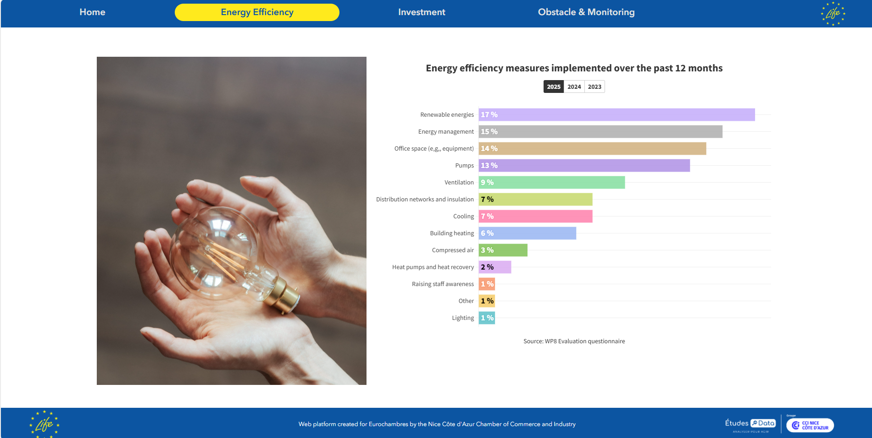
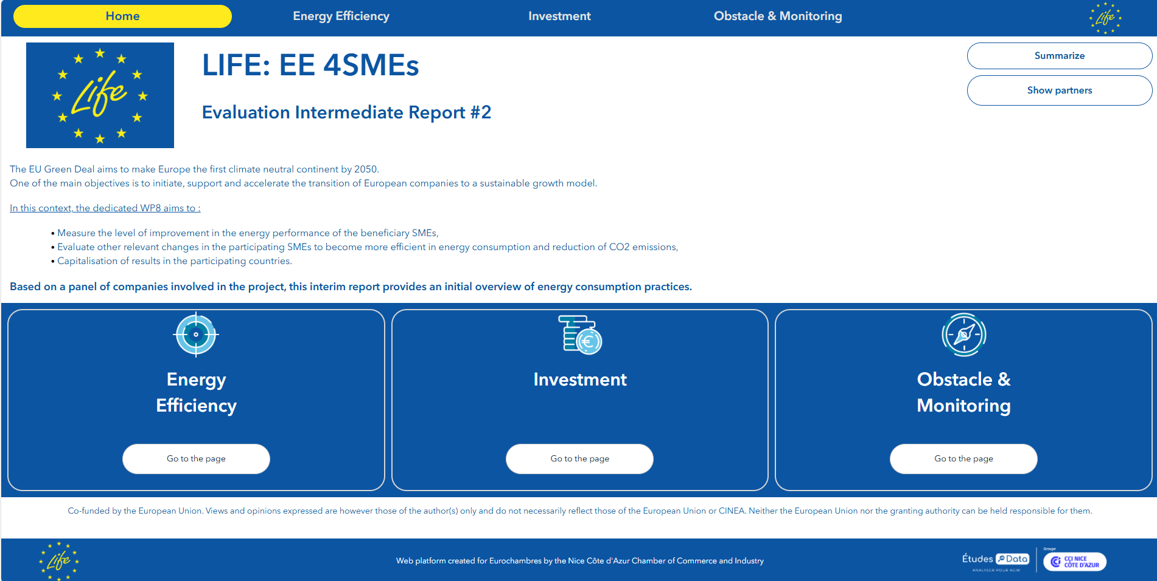
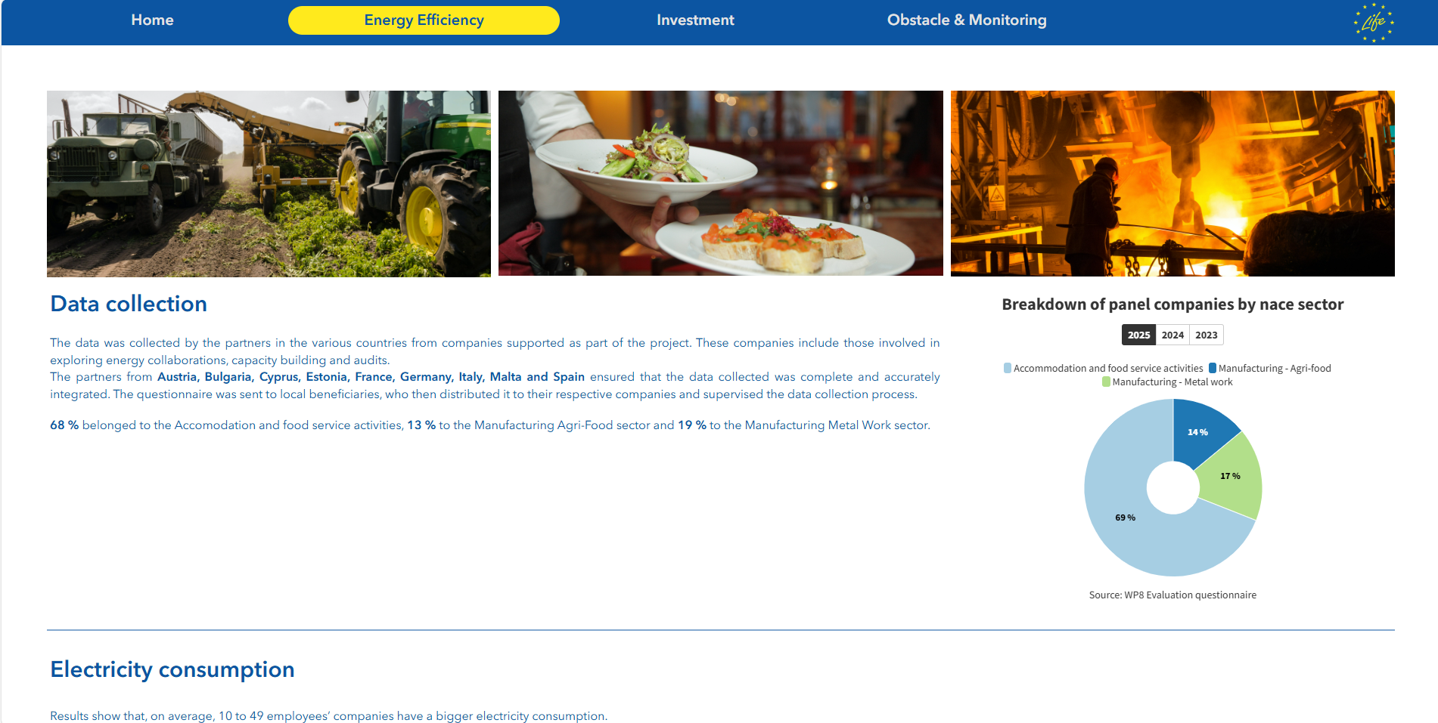
EnergyEfficiency4SMEs
Co-Funded by the European Union
Going Further
DataVisulation Tool: Showcasing annual survey results

Slide 24
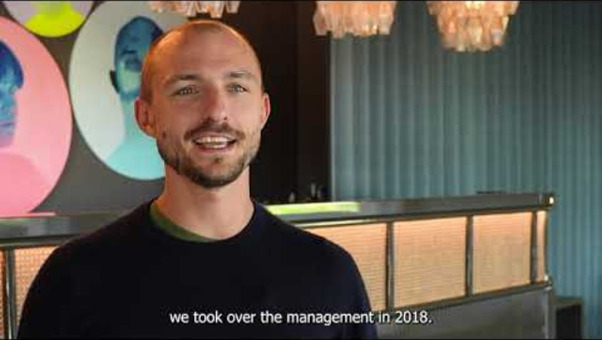
EnergyEfficiency4SMEs
Co-Funded by the European Union
Beneficiary from Agro-food sector

Slide 25
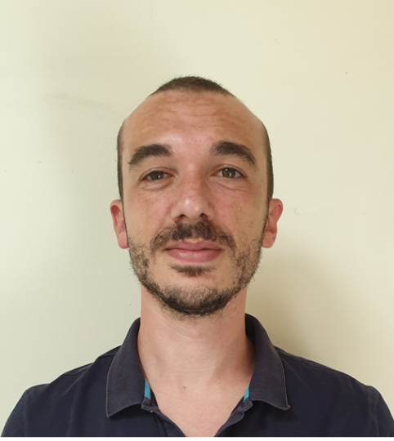
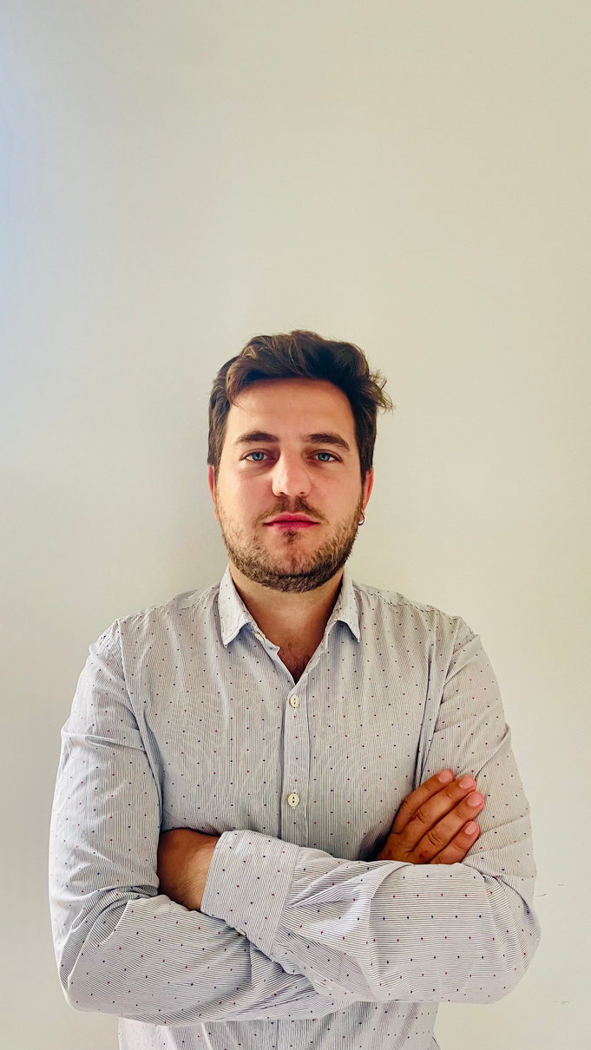

EnergyEfficiency4SMEs
Co-Funded by the European Union
Speakers
Ing Nicholas Brincat
Stefano Zamparo
Dr Giuseppe Emmi
Energy Consultant and Auditor
Project Manager
Energy Management Expert at IUAV Venice University

Slide 26
EnergyEfficiency4SMEs
Co-Funded by the European Union
ENERGY EFFICIENCY IN ACTION:
Equipping SMEs for a Green Transition
Malta experience
www.ee4sme.com

Slide 27
EnergyEfficiency4SMEs
Co-Funded by the European Union
Outcome of Energy and Water Audits conducted on Accommodation Premises in Malta

Slide 28
EnergyEfficiency4SMEs
Co-Funded by the European Union
Why focus on Water?
Potable Water Blend (2024 WSC)
Ground Water 34% (25.7 million m³)
Seawater ROs 66%(13.1 million m³)
New Water 1.6 million m³ (agriculture use)
Rainfall -10.3mm per decade (1952- 2020)
The annual rainfall for 9 out of the last 10-years was below the average of 550mm
Embodied Energy 3.532 kWh/m³

Slide 29
EnergyEfficiency4SMEs
Co-Funded by the European Union
Audit Metrics

Slide 30
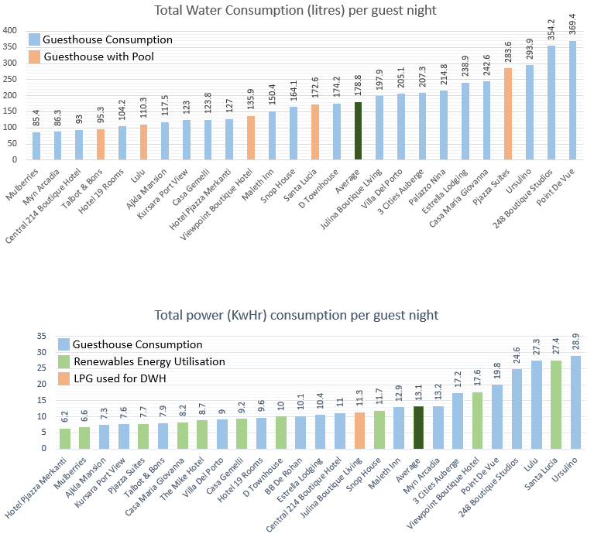
EnergyEfficiency4SMEs
Co-Funded by the European Union
Resource Consumption Metrics

Slide 31
EnergyEfficiency4SMEs
Co-Funded by the European Union
Resource Distribution

Slide 32
EnergyEfficiency4SMEs
Co-Funded by the European Union
Resource Savings
Savings | Units | Savings | Cost | ROI (yrs)
Power Savings from Flow Reduction (kwh) | 21,817 | €2,836 | €3,650 | 0.59
Power Savings from Standby Water Heaters (kwh) | 21,133 | €2,747 | €6,365 | 2.32
Limiting AC Temperatures (kwh) | 16,721 | €2,173 | €5,715 | 2.63
Total Energy Savings (kwh) | 59,671 | €7,757
Energy Savings as % of Consumption |  | 8.1%
Water Savings from Faucets (cbm) | 1,339 | €3,347 | €0
Water Savings as % of Consumption |  | 18.5%
Total Cost Savings |  | €11,105
60,000 units in direct electrical consumption,
1,340 cubic meters of water, which locally would require a further approx. 4,732 kWh to produce through the Reverse Osmosis plants.

Slide 33
EnergyEfficiency4SMEs
Co-Funded by the European Union
Lessons Learnt

Slide 34
EnergyEfficiency4SMEs
Co-Funded by the European Union
Positive Practices
Year round running of hot water on Solar Water Heaters
Good room management for switching AC on/off
Proper implementation of overhangs and building fabric insulation/design
Proper implementation of passive measures, such as passive ventilation and shading
Training of housekeeping
Remote control of water heaters and ACs
Heat reclamation from heat pump exhaust
Data collection and analysis

Slide 35
EnergyEfficiency4SMEs
Co-Funded by the European Union
General Shortcomings
Only 32% engaged professionals in the design of the premises
Lack of basic concepts such as dark green roofs, unshaded courtyards in summer, uninsulated pipework
Relying on common hearsay rather than actual facts
64% of guesthouses had water flow rates exceeding recommended rates
43% of properties had storm water reservoir, and only half of those used it
Deteriorated AC refrigerant insulation
Water heater thermostat left maximum all year long

Slide 36
EnergyEfficiency4SMEs
Co-Funded by the European Union
Guest Behaviour
Biggest and most unpredictable variable
Overall tendency of carelessness with resources
ACs are set to extreme temperatures
Windows are open and the AC is left switched on
Room keys are bypassed so AC does not switch off
Guests ask for duvet in summer and then lower AC temperatures
Extensive use of water during showering
Leaving water taps running to enjoy water sound calming effect

Slide 37
EnergyEfficiency4SMEs
Co-Funded by the European Union
Guesthouse Operators
Stretched thin for time, most have one person covering all operational aspects
Inadequate technical knowledge and at times oblivious to their lack of knowledge
Restricted financial means
Lack of funding awareness
Bureaucratic funding application process
Loss of business for during modifications
Loss of business and consultancy fees are not included in funding/incentives

Slide 38
EnergyEfficiency4SMEs
Co-Funded by the European Union
Guesthouse Operators
Stretched thin for time, most have one person covering all operational aspects
Inadequate technical knowledge and at times oblivious to their lack of knowledge
Restricted financial means
Lack of funding awareness
Bureaucratic funding application process
Loss of business for during modifications
Loss of business and consultancy fees are not included in funding/incentives

Slide 39
EnergyEfficiency4SMEs
Co-Funded by the European Union
Next Step

Slide 40
EnergyEfficiency4SMEs
Co-Funded by the European Union
Implementation Metrics

Slide 41
EnergyEfficiency4SMEs
Co-Funded by the European Union
Reasons for Lack of Implementation

Slide 42
EnergyEfficiency4SMEs
Co-Funded by the European Union
Grants Facilitated by the Project

Slide 43
EnergyEfficiency4SMEs
Co-Funded by the European Union
ENERGY EFFICIENCY IN ACTION:
Equipping SMEs for a Green Transition
Vecom Meccanica SRL
www.ee4sme.com

Slide 44
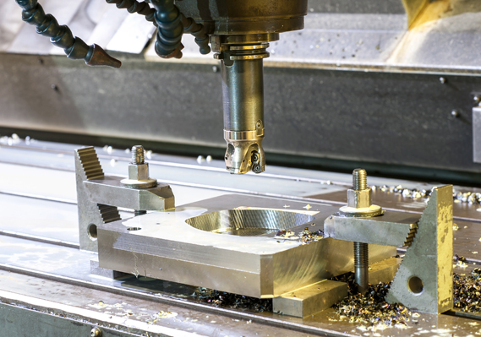
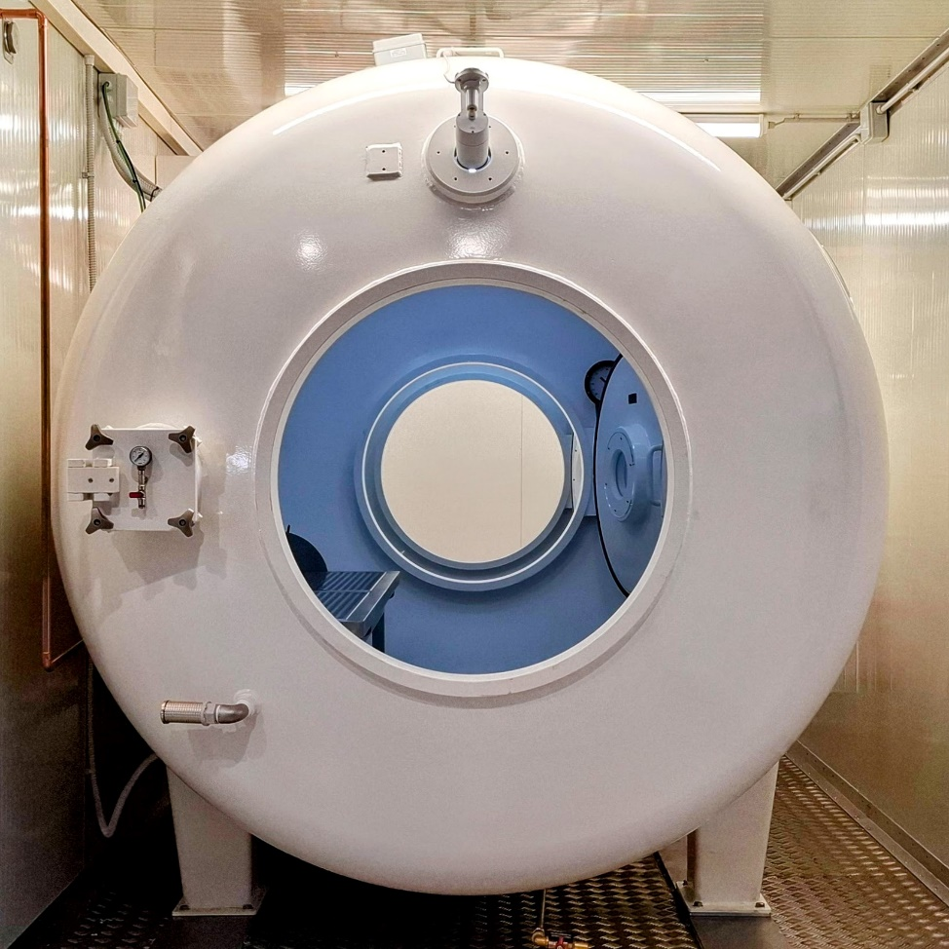
EnergyEfficiency4SMEs
Co-Funded by the European Union
Vecom Meccanica SRL
Family-owned company based in Padua, Italy – 70 years of experience
→ Specialized in mechanical and metalworking production on commission
→ 1,850 m² facility (offices and work space)
Core values: precision, reliability, flexibility
Equipment: 3 milling machines and 2 CNC lathes
S. Zamparo

Slide 45
EnergyEfficiency4SMEs
Co-Funded by the European Union
The LIFE Project and the Energy Audit
EU project
Energy Audit
Vecom is partner of Union Camere Veneto
Linguistic barrier at the entrance and lack of data analysis for energy consuming
Analysis identified main consumption sources:
– 90% electricity
– 85% thermal energy
Main issues:
1. High energy demand (~70 kW, ~30 households equivalent)
2. Poor building insulation (high thermal loss)
Recommended intervention: install photovoltaic system (≈92 kW)
S. Zamparo

Slide 46
EnergyEfficiency4SMEs
Co-Funded by the European Union
Doing and after the LiFE project
Results
Future plans
Significant cost and emission reduction achieved
→ After 6 months: 40% reduction in energy consumption
→ Today solar system covers about 70% of total energy needs
Take energy efficiency mindset all around the company Invest part of “the previous cost” to new project
(→ increase the production buying new machines)
S. Zamparo

Slide 47
EnergyEfficiency4SMEs
Co-Funded by the European Union
Vecom Meccanica SRL Energy Audit
This energy audit is focused on Vecom Meccanica. The company operates within a warehouse facility, part of which was established over six decades ago, while the other part is located within a new building constructed in 2008.
The energy audit has been conducted in 2024 and the data about the energy consumptions are related to the year 2023.
Natural gas and enectrical energy is used as energy vectors in the company.
G. Emmi

Slide 48
EnergyEfficiency4SMEs
Co-Funded by the European Union
Context of the energy analisys
Metalworking Facility (Older Building)
Administrative Offices (Newer Building)
Approximately 1600 square meters
1000 square meters of office space across second and third floors
Most of the building is not thermally insulated
Shed roof at approximately 12 meters height
Modern architectural features, glass facades, upper thermal insulation of the building elements
Mainly dedicated to metalworking
Small office area with three workstations
Vecom Meccanica uses 250 sqm of the whole space
Daily Working Period
Daily Working Period
From 6 am to 9 pm
From 6 am to 7 pm
G. Emmi

Slide 49
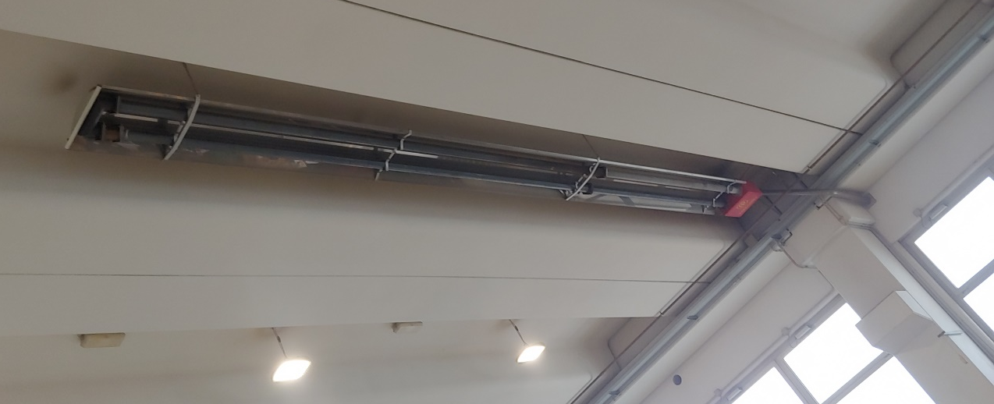
EnergyEfficiency4SMEs
Co-Funded by the European Union
Thermal Energy Consumption
Gas consumption in 2023 was 9665 Sm³, converting to approximately 92700 kWh (LHV: 9593 Wh/mc). This energy is primarily for heating of the production area and offices. No relevant demand is due to the metalworking instrumentation.
Metalworking Facility (Older Building)
Administrative Offices (Newer Building)
Heated by ceiling-mounted radiant tubes (10–25 kW) using high-temperature fumes.
Thermal generation with two condensing boilers, 49,8 kW each (NATURAL GAS)
High building with poor insulation, thermal stratification → high energy consumption
Cooling is obatianed by the use of chillers, 19.4 kW and 17.8 kW (ELECTRIC ENERGY)
Fan coils provide both heating and cooling.
G. Emmi

Slide 50
EnergyEfficiency4SMEs
Co-Funded by the European Union
Electricity Consumption
The electrical substation size is 92 kW.
Analyzing the consumption data for 2023 reveals a total consumption of 139’000 kWh, distributed across three time slots as is common for industrial activities, with a predominance of the F1 slot (=daytime electrical consumption). In this case, F1 consumption corresponds to 70% of the total consumption.
The highest electricity consumption is attributed to mechanical production machinery:
3 milling machines
2 lathes machines
The lighting is partially but not entirely LED-based, both in the workshop and in the offices
70 kW
G. Emmi

Slide 51
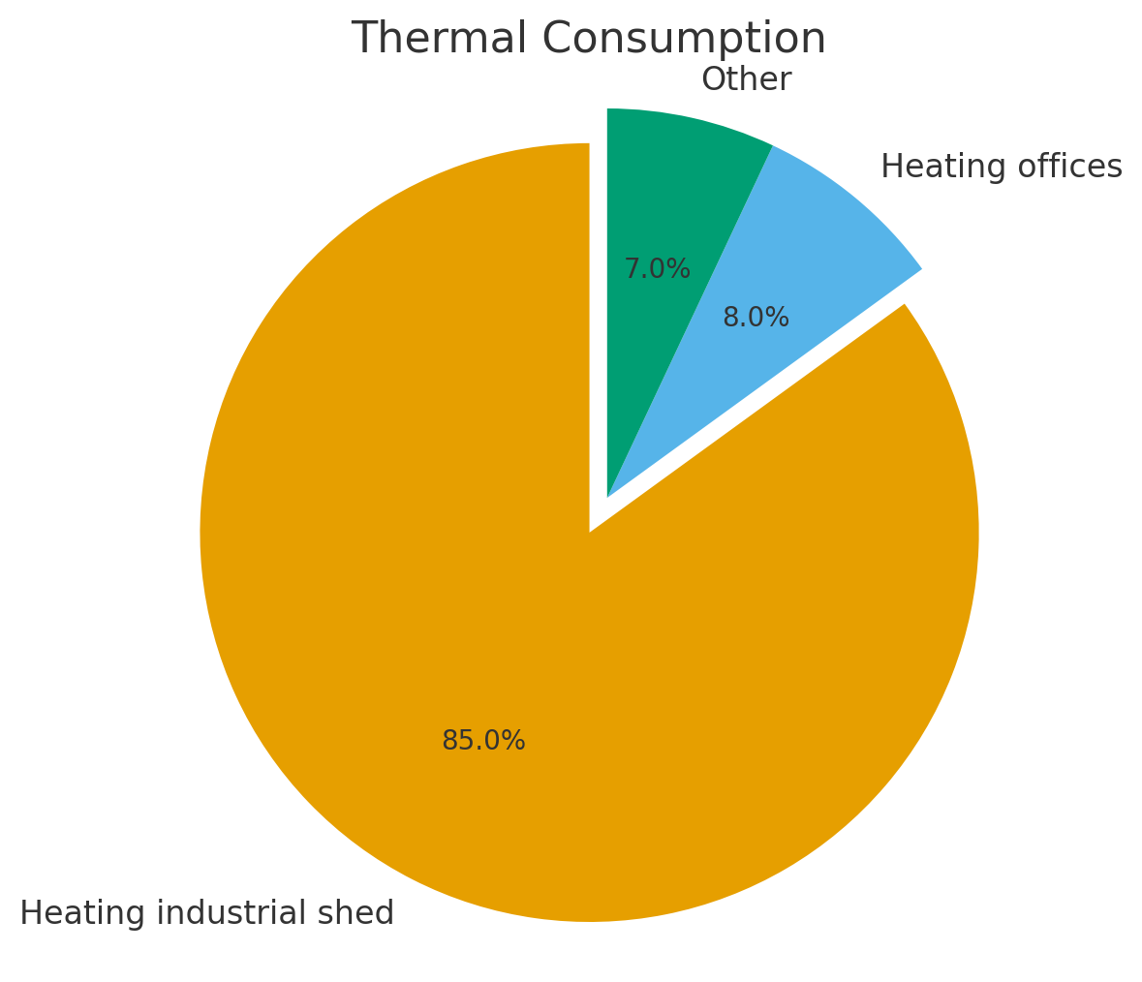
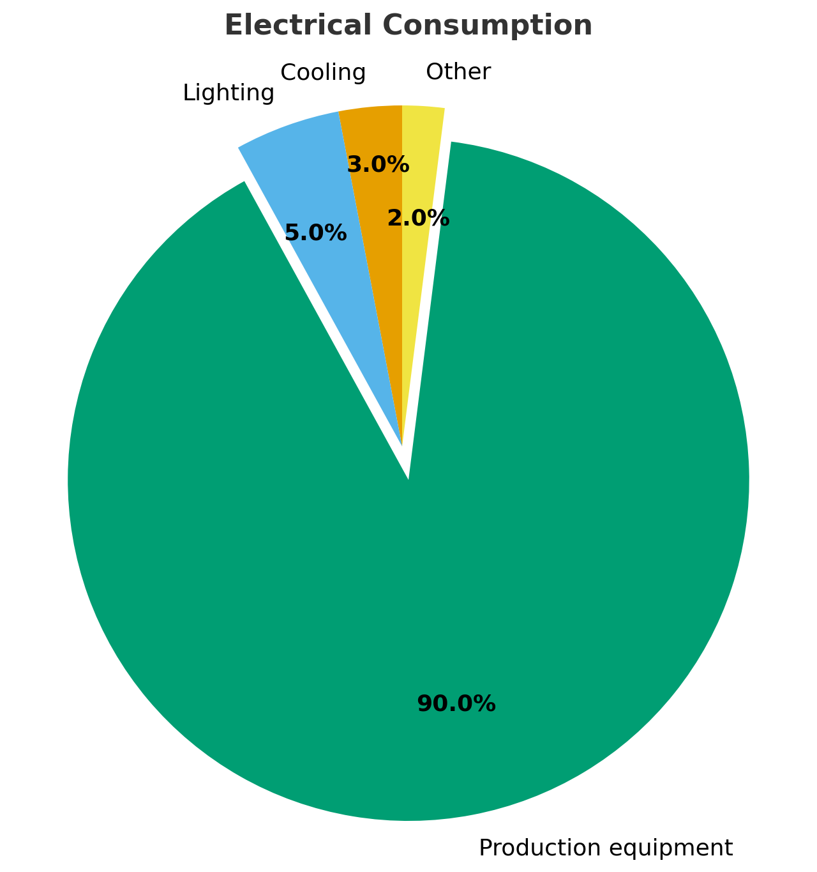
EnergyEfficiency4SMEs
Co-Funded by the European Union
Share of the Energy Consumption
The audit collects overall consumption data from purchase invoices for electricity and gas, focusing on annual consumption patterns from the data available in 2023.
Natural Gas
Electrical Energy
G. Emmi

Slide 52
EnergyEfficiency4SMEs
Co-Funded by the European Union
Energy efficiency improvement opportunities
Best practices:
Energy efficiency improvement opportunities:
Prioritize sourcing green energy.
Install a 92 kWp photovoltaic system: This is the most economically advantageous intervention, projected to enable approximately 60% on-site energy self-production.
Maximize on-site generation from renewable sources.
Efficient management and timely monitoring of energy usage across all operations.
Install electricity meters for equipment.
Power factor correction: Reduce grid demand by addressing inductive loads in the electrical system.
Adopt green energy procurement policies.
Implement regular inspections with preventive maintenance.
Economically impractical (due to unfavorable payback times):
Upgrading building envelopes for thermal loss reduction.
Replacing the workshop's heating system with an electric VRF.
G. Emmi

Slide 53
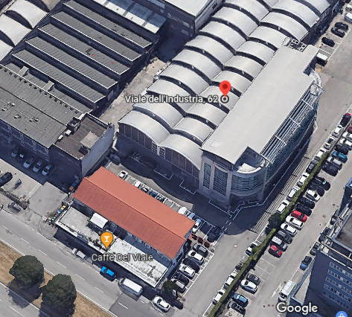
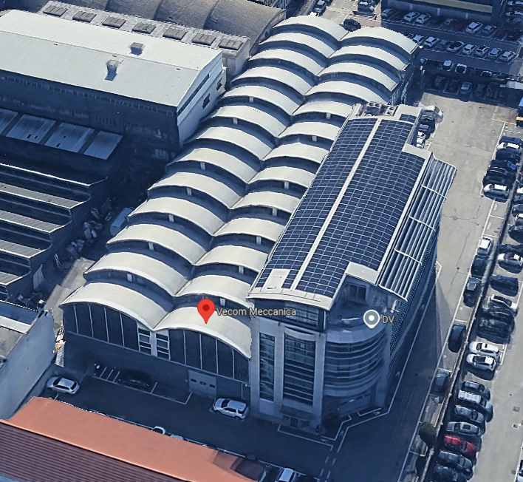
EnergyEfficiency4SMEs
Co-Funded by the European Union
… good news
2024
2025
… thank you for your attention

Slide 54
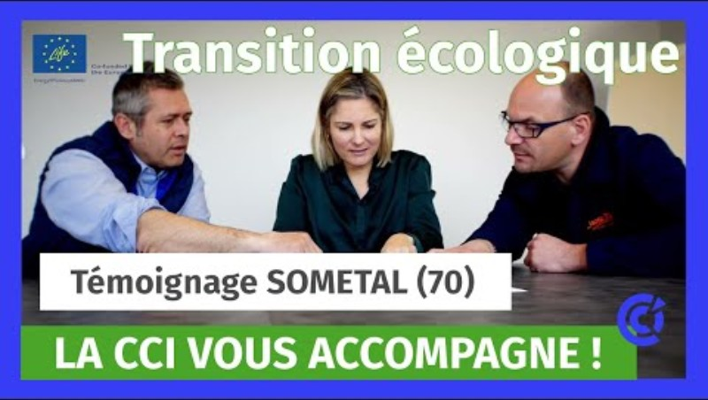
EnergyEfficiency4SMEs
Co-Funded by the European Union
Beneficiary from Metalwork sector

Slide 55
EnergyEfficiency4SMEs
Co-Funded by the European Union
Coffee break

Slide 56
EnergyEfficiency4SMEs
Co-Funded by the European Union
Beyond Energy Savings: Unlocking the Full Value of the SME Energy Transition

Slide 57
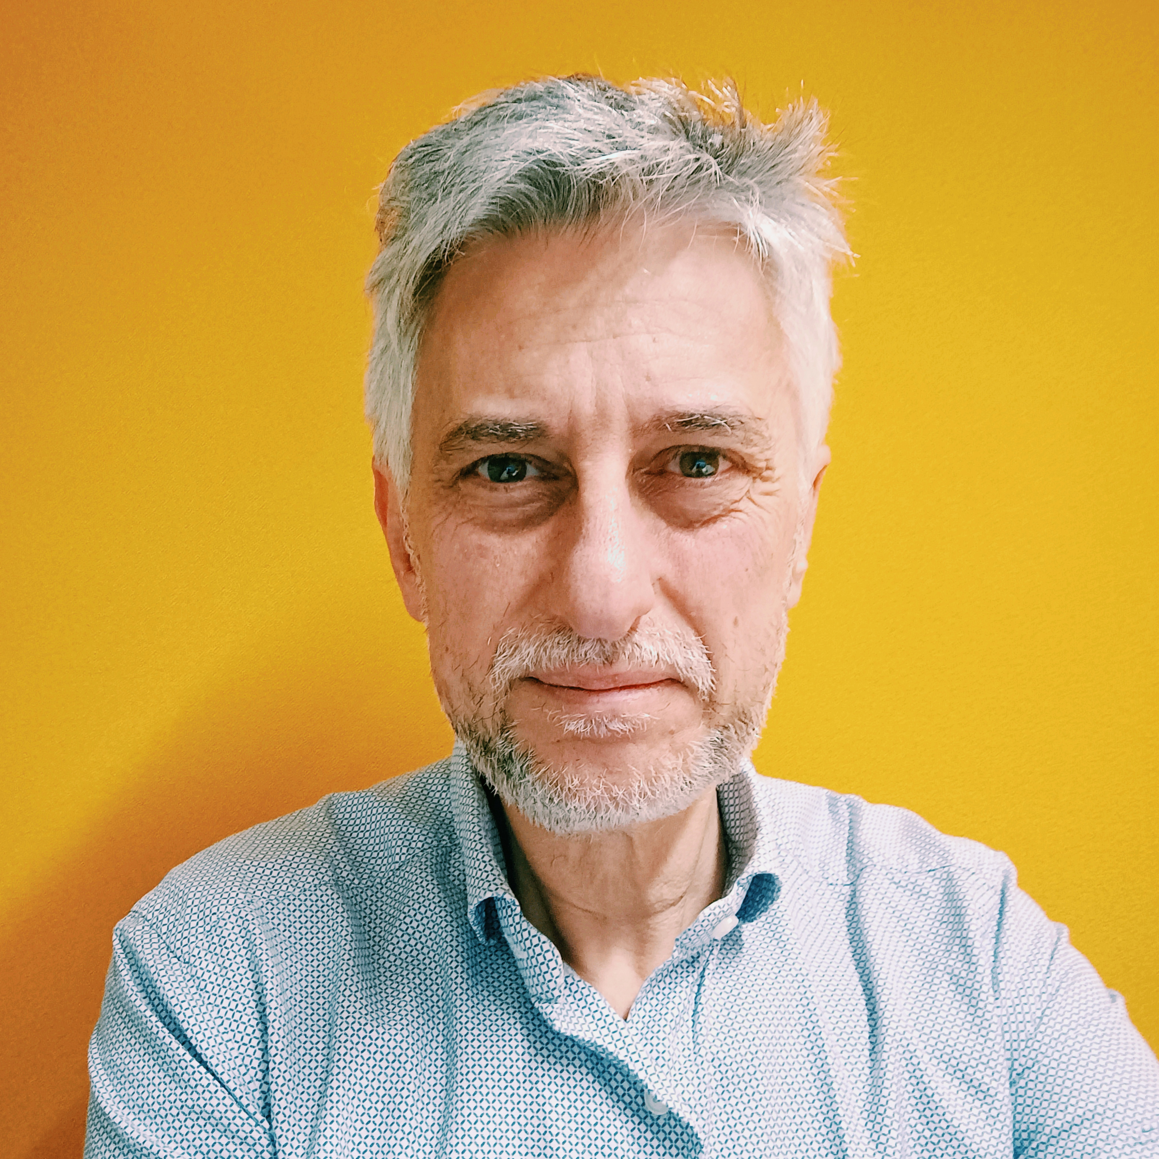


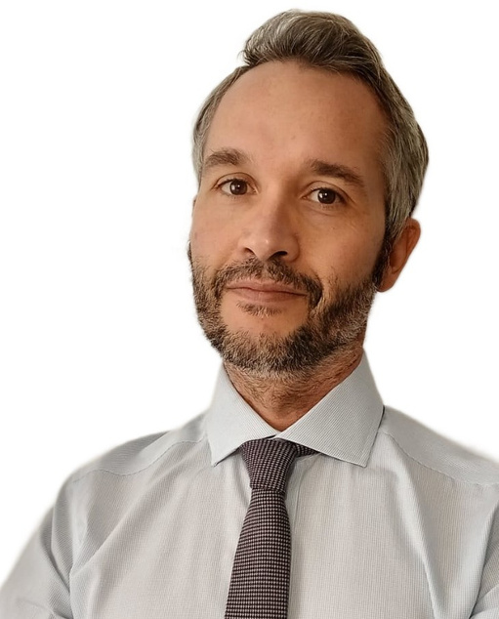
EnergyEfficiency4SMEs
Co-Funded by the European Union
Speakers
Giuseppe Saija
Claudia Julius
DI Dr Georg Benke
Enrico Biele
Project Officer, CINEA
Project Officer, CINEA
Project Officer, CINEA
Project Officer, CINEA
Project Manager at Fondazione Fenice Onlus
Project Manager at SEnerCon
e7 energy innovation & engineering
Programme Manager at ENEA and LEAP4SME Coordinator

Slide 58
EnergyEfficiency4SMEs
Co-Funded by the European Union
ENERGY EFFICIENCY IN ACTION:
Equipping SMEs for a Green Transition
Learnings from Large Enterprises

Slide 59

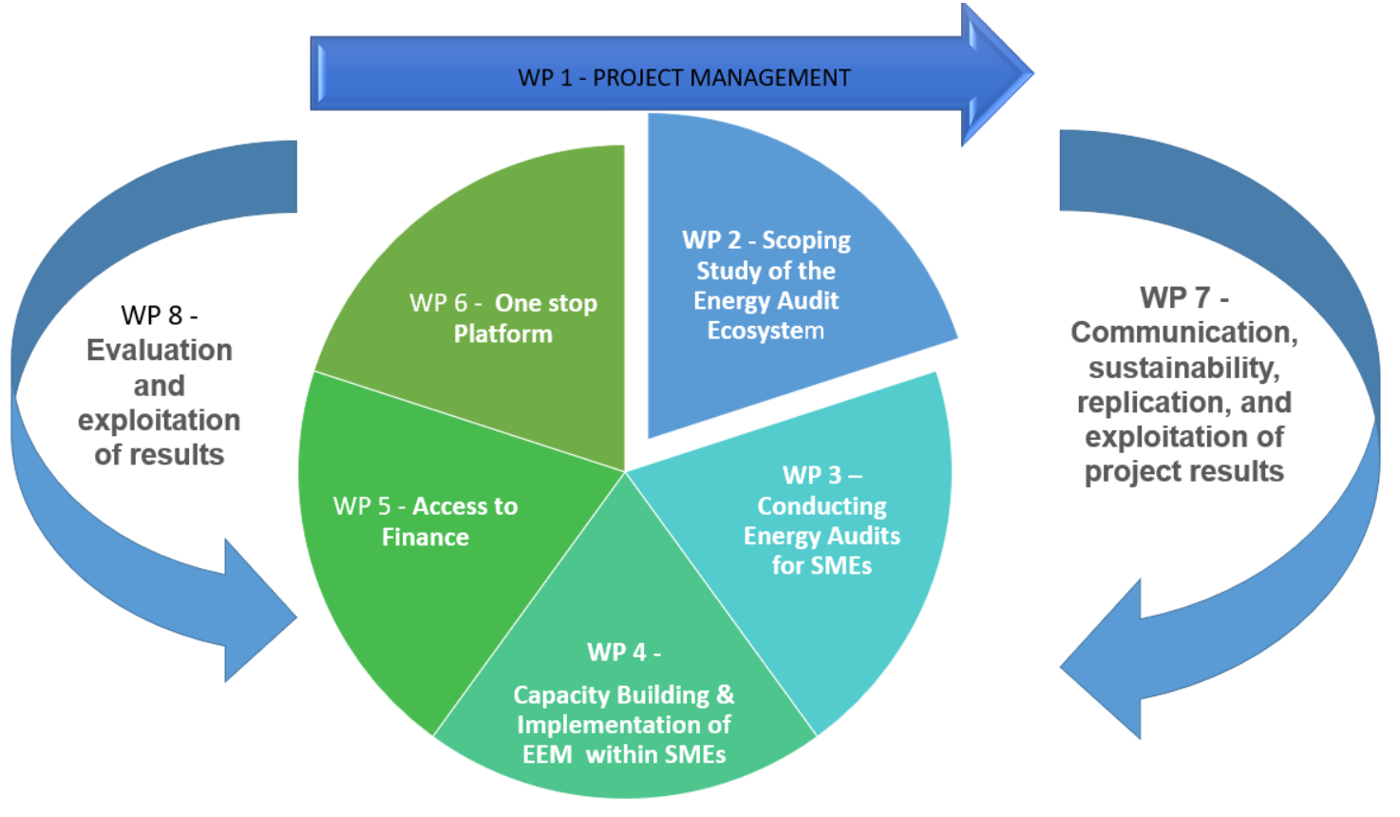
Project overview

Slide 60
WORK PACKAGE 2 MAPPING STUDY
Identification of best practices transferable from big companies to SMEs in the following NACE sectors
Metalwork manufacturing Nace C24-C25.9.9
Accommodation I55-I56.3.0
Agrifood Manufacturing C10-C11.0.7
Year 1: BP on energy identified through a Multi-Actor approach:
160 questionnaires in 7 countries
Input from partners and energy experts
Results:
a strong base to understand the state of the art of the energy efficiency measures in different countries in the 3 NACE sectors
extrapolation of the the indicators of T2.3.

Slide 61
Notes:
@Luca, this is not easy to read
As you can see the most popular measure related to lighting in particular by replacing old lighting systems with
Followed by the installation of photovoltaic panels (was there any difference related to the presence of governmental incentives?)
improved efficiency of spatial cooling equipment?
Followed by other measures, including new generation boilers, or electric vehicles or purchase of certified electricity (let’s say some measures that don’t necessarily need long term ROI investments)

Slide 62
Notes:
In this case, after the replacement of old lighting with LED, other measures appear more popular, such as the inverters for macinery or heat recovery systems. Of course this is to be expected in plants where metals are worked at very high temperatures, which allows significant optimisation in that respect
You might also notice that some soft measures like «upgrading skills» are indicated, which were not indicated in the previous sector of agrifood manufacturing (we don’t know whether this might have depended on specific incentives available for training)

Slide 63
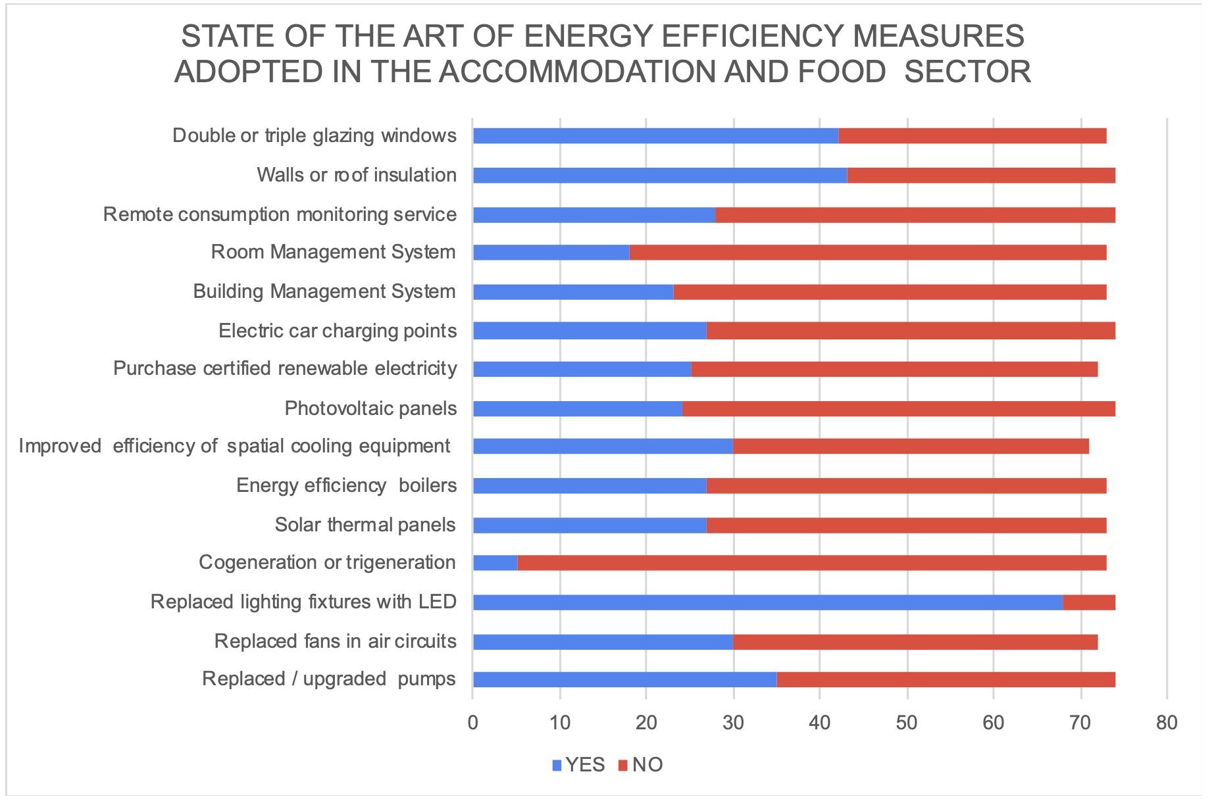
Notes:
Again, LEDs win, but other sector-specific measures are taken
In particular, when it comes on places where the main business is having people staying for the night, insulation measures are privileged, like double or triple glazing or roof and walls insulation
Also upgraded pumps and better efficiency of cooling

Slide 64
WORK PACKAGE 2 MAPPING STUDY
The measures belong to three spheres:
Technical: deeply analysed in the indicators
Behavioural: raising awareness on staff and customers
Contractual: strategic choice of the business owner (e.g. purchase of energy from renewable sources)
Notes:
We may also conclude that the choices can usually be distinguished in three ain categories: technical; behavioural and contractual (technical have an immediate optimisation effect, but may be linked to long-term investments; behavioural touches upon the behaviour of managers and workers; contractual may sometimes be more opportunity based depending on specific market conditions or arrangements

Slide 65
Best Energy efficiency measures applicable to SMEs
https://www.fondazionefenice.it/wp-content/uploads/SET-OF-INDICATORS-EE4SME-.xlsx
Notes:
In this case, I am not suggesting you read the details… this is just the link to the set of indicators that have been worked out in the project + the estimated impact values in terms for instance of energy saved or payback time. These indicators are also calculated distinguishing roughly between the geographical situations in north, central or southern europe. It goes without saying the photovoltaic panels may offer different performances depending on weather between Lapponia and Sicily

Slide 66
Best Energy efficiency measures appliable to SMEs
https://www.fondazionefenice.it/wp-content/uploads/SET-OF-INDICATORS-EE4SME-.xlsx

Slide 67
CASE STUDIES
The 160 responses, combined with desk research and audits, led to the development of 14 case studies, summarized in a concise leaflet to communicate and promote the project. Additionally, this leaflet serves as a tool for fostering dialogue with companies regarding audit trials and the implementation of measures
Notes:
Not everyone likes going through data sheets of course, so we did some effort to identify interesting case studies that could be of inspiration. We came up with 14 of those, out of the 160 analysed and we summarised them in a leaflet which was one of the key communication tools we have used to disseminate information about the project and amplify its impact

Slide 68
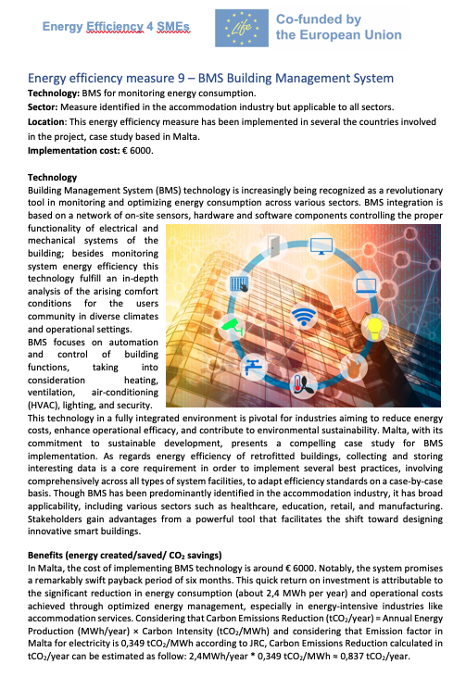
CASE STUDIES
Methodology 160 Responses to questionnaires Desk research Audits
The 14 case studies have been collected and summarised in an information leaflet. The leaflet serves as a tool for fostering dialogue among
companies about
the implementation
of measures
The Leaflet is
available HERE
14 Case Studies
Photovoltaic Panels
LED Lighting
Sustainable Energy Procurement
Chillers
Heat recovery ventilation
Building insulation
Solar thermal collectors
Heat recovery from air compressors
Building Management System (BMS)
New machineries with inverters
Soft efficiency measures
Heat pump
Direct evaporators
Hybrid boilers
Notes:
Not everyone likes going through data sheets of course, so we did some effort to identify interesting case studies that could be of inspiration. We came up with 14 of those, out of the 160 analysed and we summarised them in a leaflet which was one of the key communication tools we have used to disseminate information about the project and amplify its impact

Slide 69
SOME EXAMPLE OF CASE STUDIES:
Notes:
The idea with the leaflet was to identify practices that would be applicable in different countries and contexts

Slide 70
EE4SME TAKE HOME MESSAGES
Learning from Large Enterprises
Adapting best practices and operational models from large enterprises to the specific needs of SMEs, enabling them to streamline operations and implement efficient energy management strategies
Take-home message: Large enterprises often anticipate actions that SMEs may adopt. EE4SME adapts these best practices to the specific needs of SMEs, highlighting how small businesses can streamline operations and implement efficient energy management strategies.
2. Energy Audits
Useful initial tool to raise awareness about energy efficiency within SMEs, helping them identify inefficiencies and untapped potential
Take-home message:
By identifying operational inefficiencies, audits enable organizations to pinpoint areas for improvement and lay the groundwork for informed, strategic decisions that drive long-term sustainability and cost reduction
3. Energy Performance Indicators (EPIs)
Employing EPIs and savings indicators to quantify the cost-benefit of different energy-saving measures, enabling SMEs to make informed decisions about energy-efficient investments.
Take-home message: EPIs and savings indicators enables SMEs to quantify the cost-benefit of various measures. This empower decision-makers to make data-driven informed choices for the optimal allocation of resources and maximizing long-term savings.
Notes:
@luca do I have to say something about the implementation of the energy audits?
Energy audits are anyway very useful tools, even if no immediate action is taken, to point companies and managers to inefficiencies and more importantly to solutions that could improve their
EPI – very important to provide examples of what works or works best and what does not also per type of sector or geographical area, including examples coming from best practices
IMPAWATT we will have another distinguished speaker illustrating the details and the most recent updates

Slide 71
EE4SME TAKE HOME MESSAGES
4. IMPAWATT Platform Leveraging the IMPAWATT platform, which consolidates best practices and European projects on energy efficiency, providing SMEs with valuable resources for learning and implementation.
Take-home message: This platform serves as a comprehensive tool to enhance corporate culture on sustainability and energy efficiency, offering SMEs essential insights for effective learning and practical implementation.
5. Training and Capacity-Building
Targeted training sessions to SME personnel to foster a culture of energy efficiency within organizations, improving skills and knowledge.
Take-home message:
Continuous learning is essential for long-term success. These sessions empower staff to implement effective energy-saving practices, adapt to new technologies, and drive sustainable growth. This also ensures SMEs remain competitive in an ever-changing environment
6. Consulting Services for Accessing Funding Providing consulting services to guide SMEs in
accessing financial support for energy efficiency projects, ensuring they have the resources needed to implement energy-saving measures.
Take-home message: Consulting services are strategic for guiding SMEs through the process of accessing funding for energy efficiency projects. This personalized support ensures that businesses have the necessary resources to implement energy-saving measures and sustainable improvements.
Notes:
@luca do I have to say something about the implementation of the energy audits?
Energy audits are anyway very useful tools, even if no immediate action is taken, to point companies and managers to inefficiencies and more importantly to solutions that could improve their
EPI – very important to provide examples of what works or works best and what does not also per type of sector or geographical area, including examples coming from best practices
IMPAWATT we will have another distinguished speaker illustrating the details and the most recent updates

Slide 72
EnergyEfficiency4SMEs
Co-Funded by the European Union
ENERGY EFFICIENCY IN ACTION:
Equipping SMEs for a Green Transition
IMPAWATT Platform

Slide 73
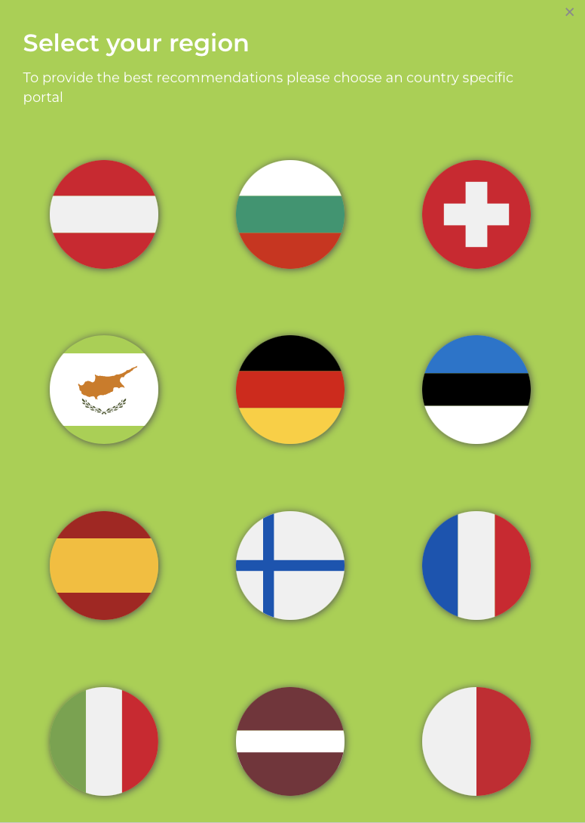

EnergyEfficiency4SMEs
Co-Funded by the European Union
Impawatt
IMPAWATT is an e-learning and energy monitoring platform offering more than 200 different training materials and tools tailored to the needs of companies in 12 countries, enabling energy and cost monitoring.
Objective: To improve the level of knowledge and implementation of energy efficiency measures in SMEs, especially after energy audits.

Slide 74
EnergyEfficiency4SMEs
Co-Funded by the European Union
Impawatt
History
Impawatt was developed under the Horizon 2020 project Impawatt and has been improved and updated since then in the three Life projects EE4SME, EE4HORECA and EcoSMEnergy.
Usage
Impawatt is available in 12 countries and languages and has been used by 837 registered companies and over 1600 users.

Slide 75

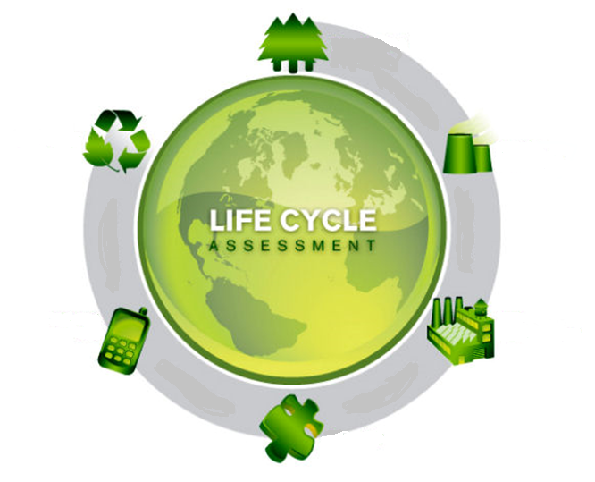

EnergyEfficiency4SMEs
Co-Funded by the European Union
Impawatt
Energy Efficiency
Energy Culture
Sustainable Supply Chain
Energy management
Processes (pumps, motors, fans, compressed air, process heat)
Buildings (heating and cooling, building envelope, ventilation, BMS)
Lighting systems
Mobility
Renewable energies
Motivation to implement energy management processes
Motivating employees to change their behavior
Training employees and reviewing their level of knowledge
Analysis of the life cycle
Guidelines for life cycle costs
Use of sustainability indicators
Environmental labeling
Sustainable business models

Slide 76
EnergyEfficiency4SMEs
Co-Funded by the European Union
How does Impawatt work
2. Information on EE Measures
Library of Measures
3. Information on Funding / Financing
1. Identification of EE Measures
Self-Assessment
Financial Tool
4. Correlation of EE Measures and Energy cons. / cost / CO2
Monitoring

Slide 77
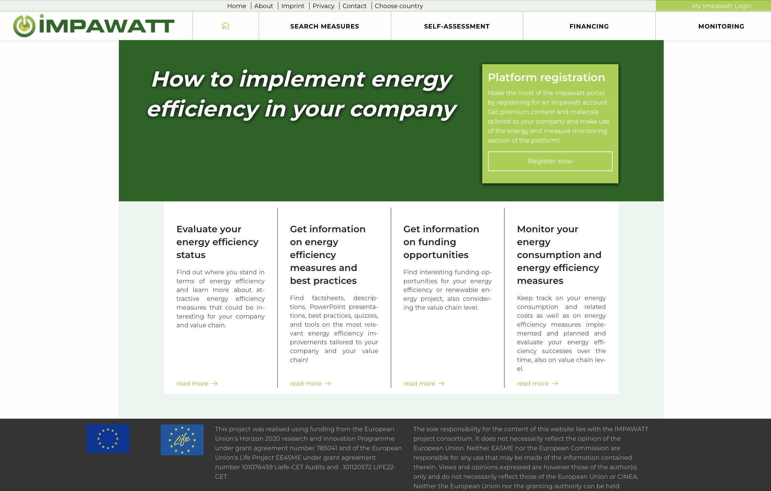
EnergyEfficiency4SMEs
Co-Funded by the European Union
How does Impawatt work – Landing Page
https://eu.impawatt.com
Four main platform features:
Self-assessment tool
Library with descriptions of EE measures,
presentations, best practices and tools
Financing tool
Monitoring section (energy consumption,
costs and EE measures)

Slide 78
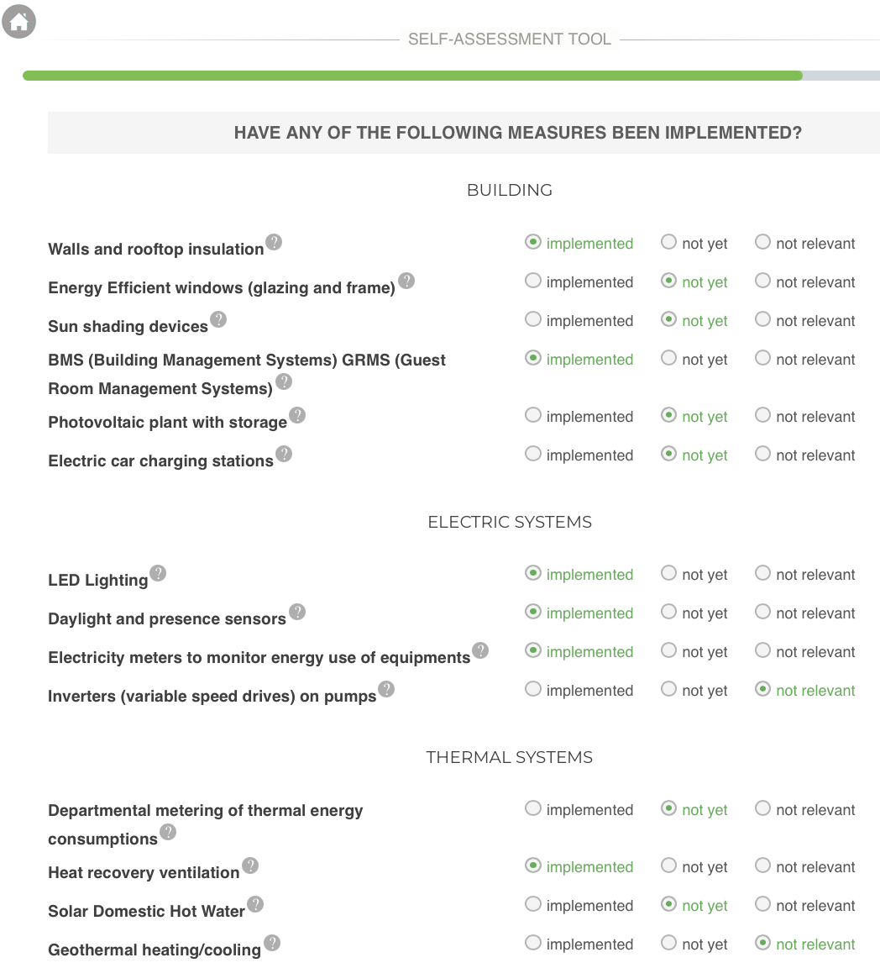
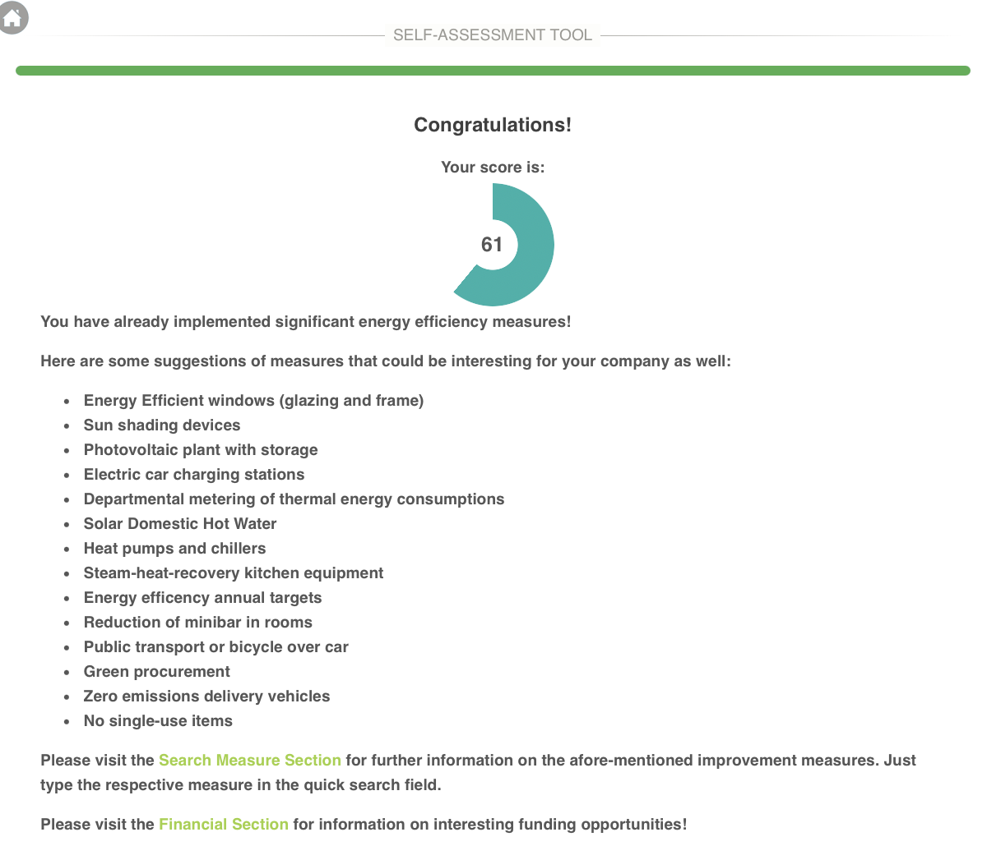
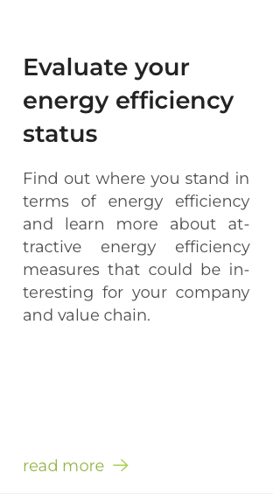
EnergyEfficiency4SMEs
Co-Funded by the European Union
How does Impawatt work – Self-Assessment Tool
Evaluation based on implemented EE measures

Slide 79
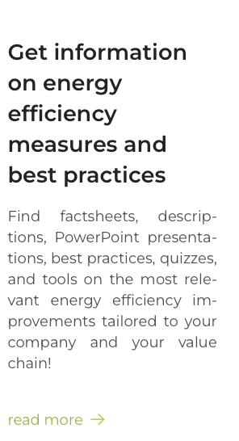
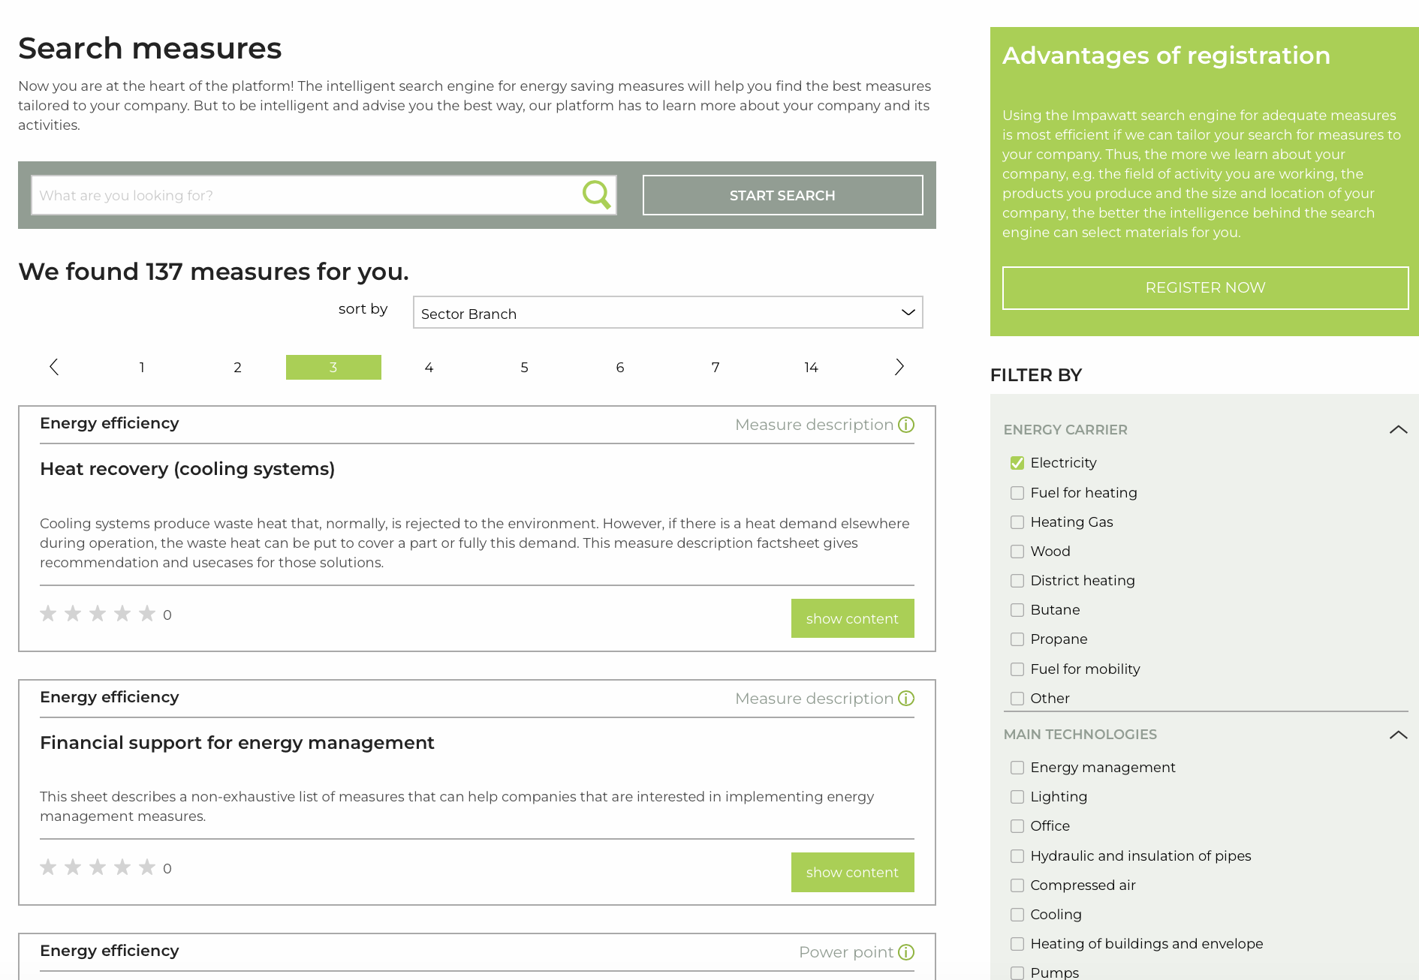
EnergyEfficiency4SMEs
Co-Funded by the European Union
How does Impawatt work – Library of Measures
Search engine applying
filtering criteria:
Energy source
Technology
Position / Role
Sector
Topic
Type of information

Slide 80
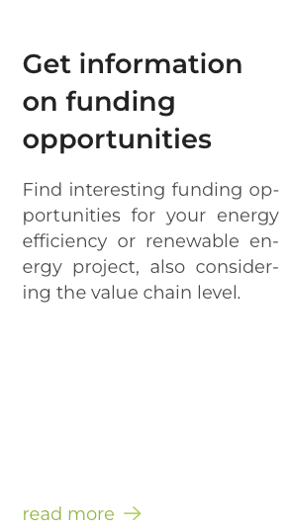
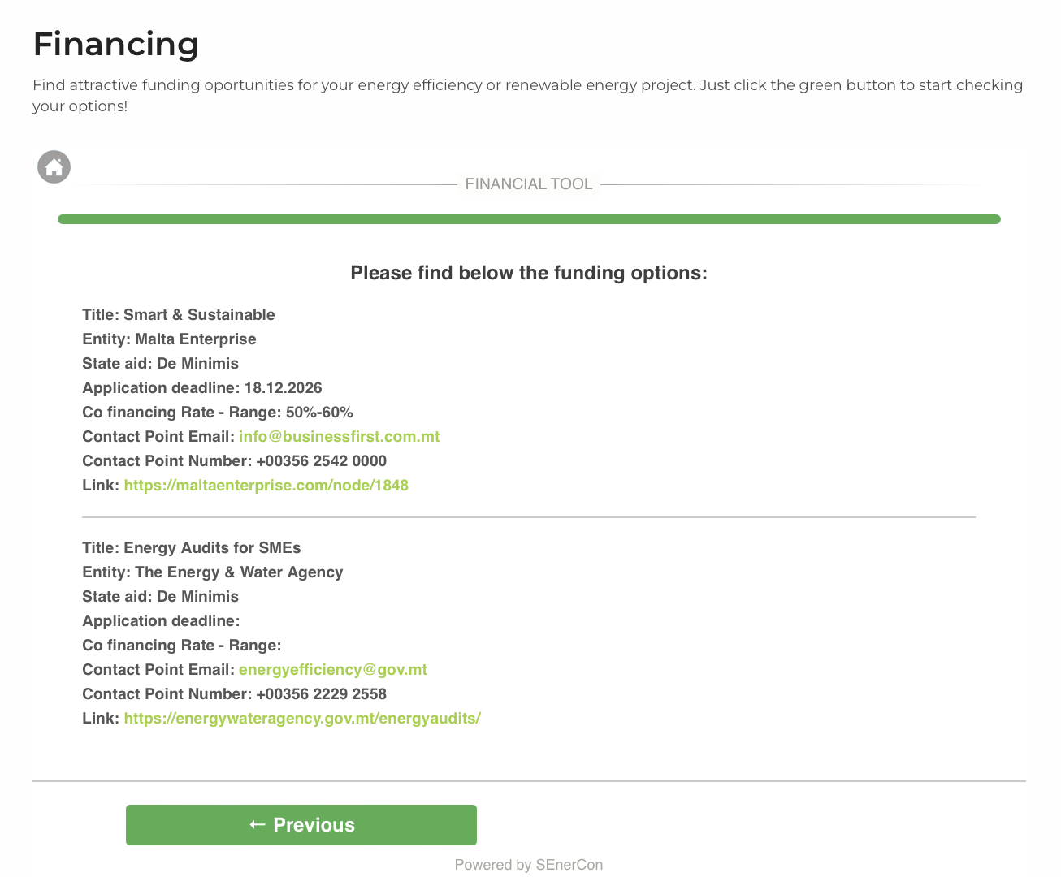
EnergyEfficiency4SMEs
Co-Funded by the European Union
How does Impawatt work – Financial Tool
Differentiated according to:
Country / Region
Sector
Topic
Type of financing

Slide 81
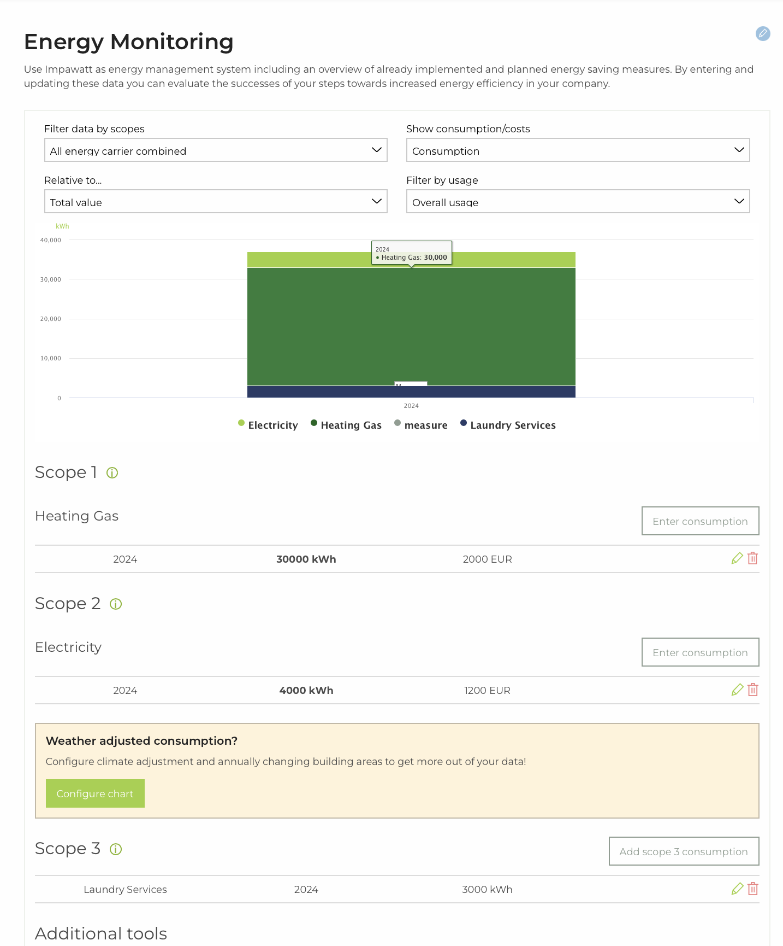
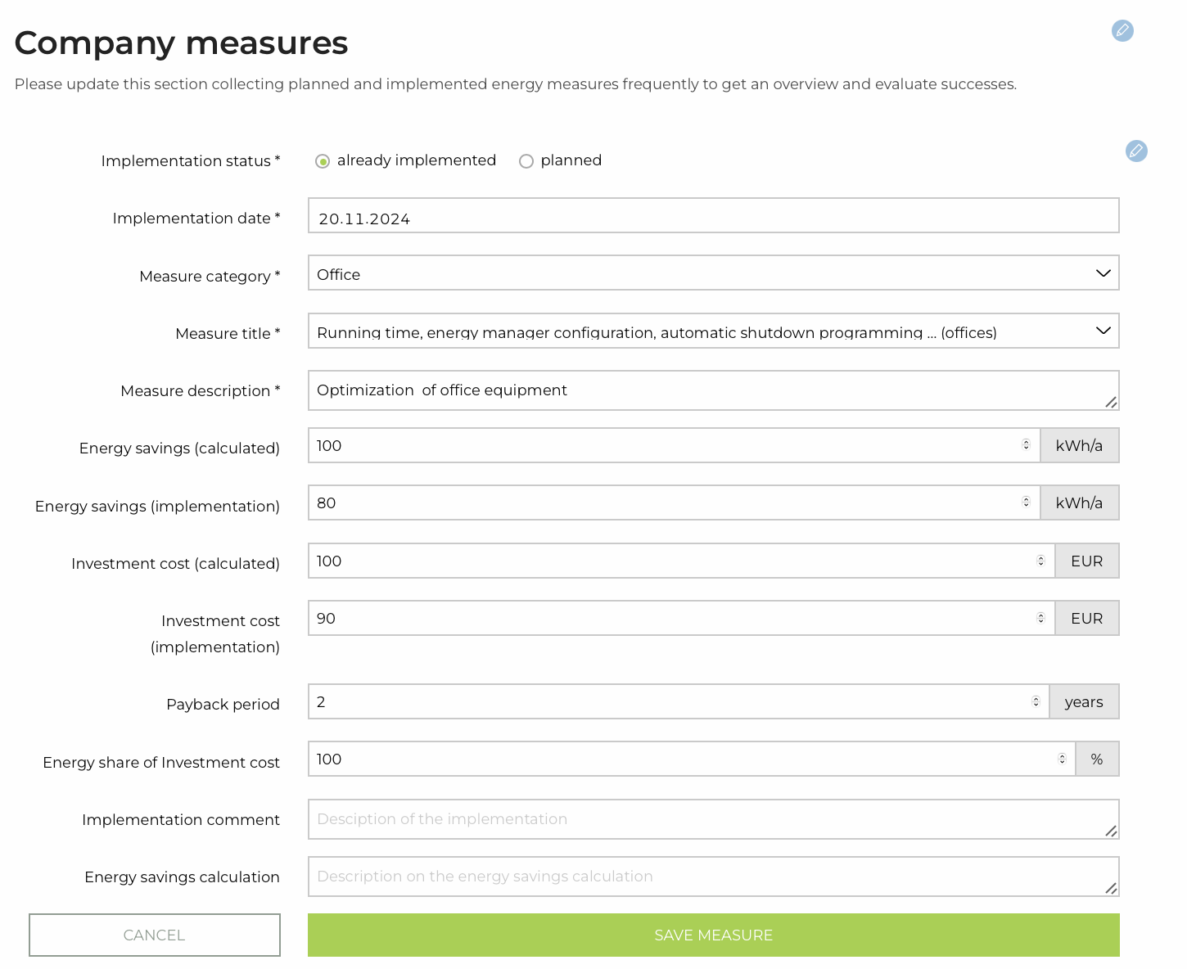
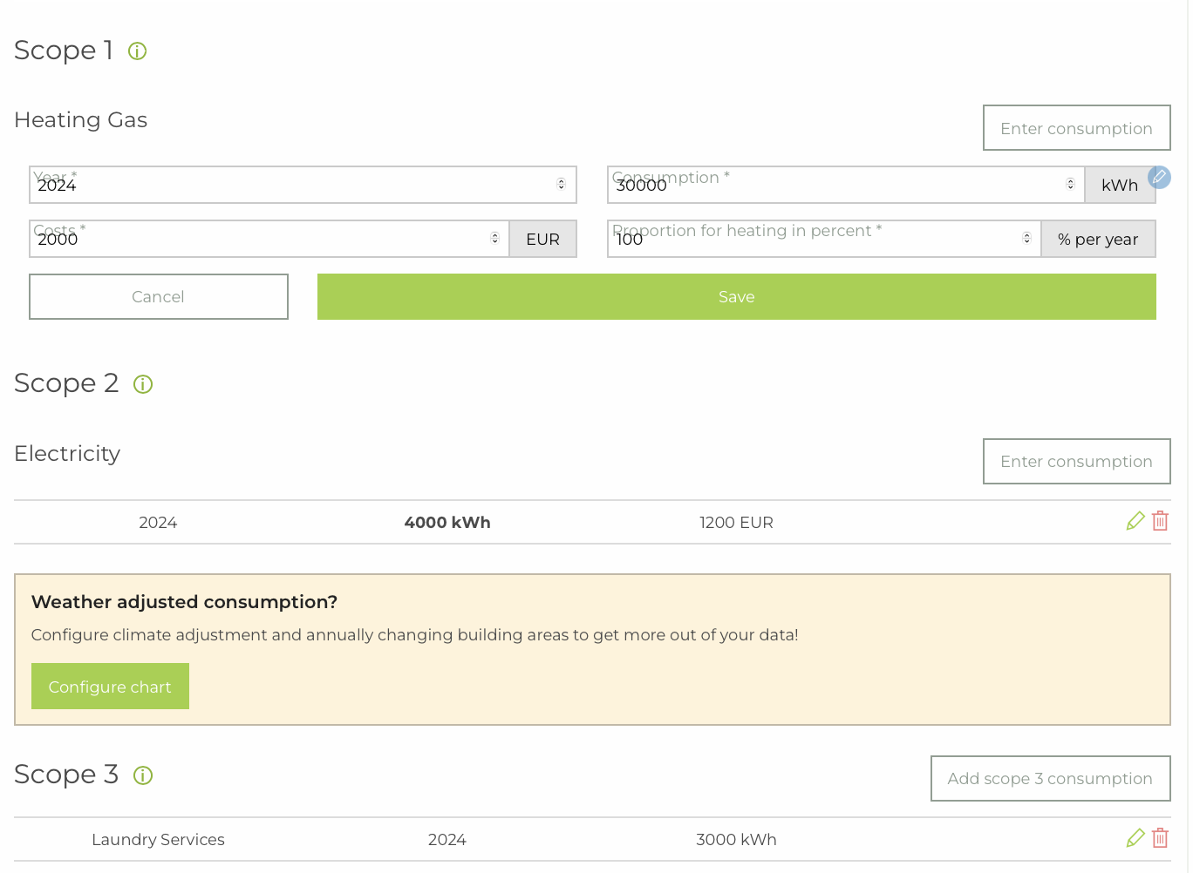
EnergyEfficiency4SMEs
Co-Funded by the European Union
How does Impawatt work – Monitoring Section
Monitoring of:
Total and specific energy consumption
Total and specific energy costs
Scope 1, 2 and 3
Energy efficiency improvements including
time stamps
Correlation to m2, produced goods,
overnight stays
Display of parameters in different charts
Additional Excel tools for calculating
the energy consumption of the value chain

Slide 82
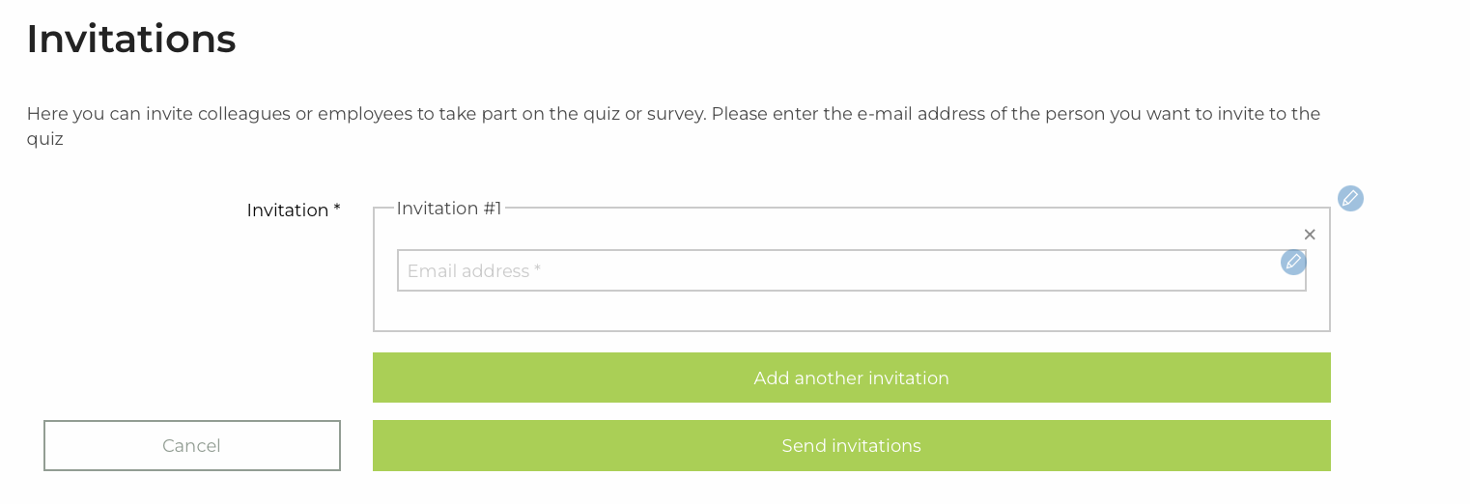
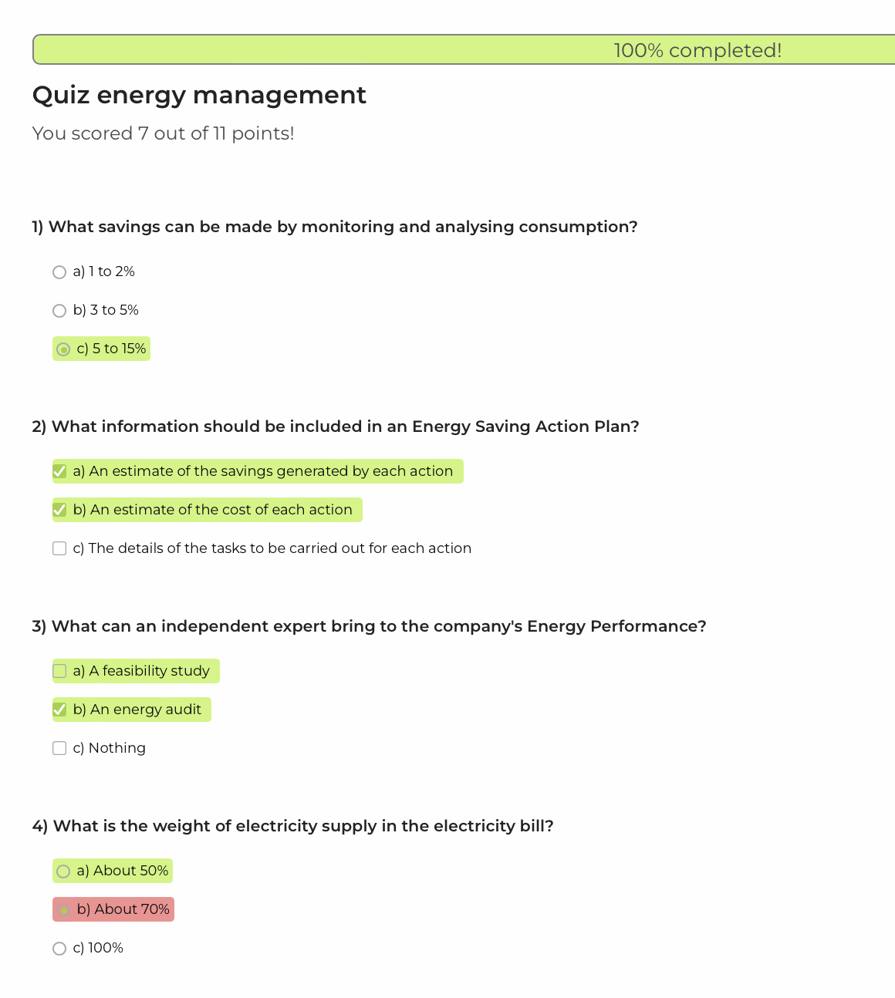
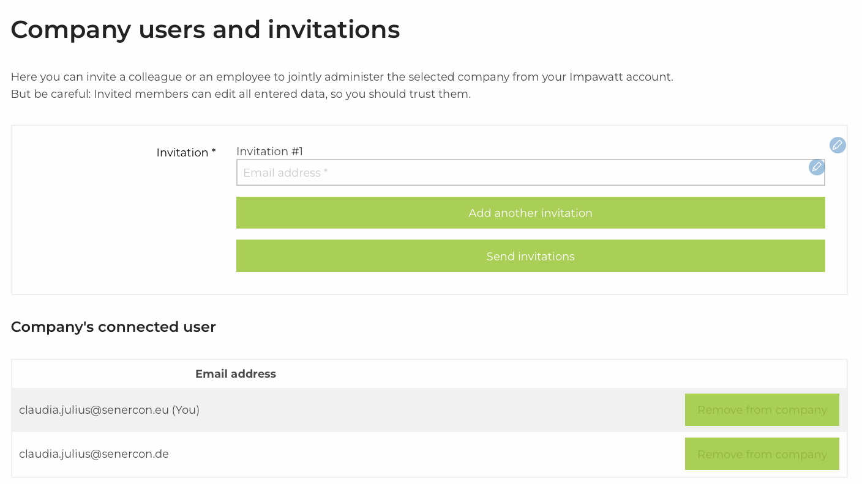
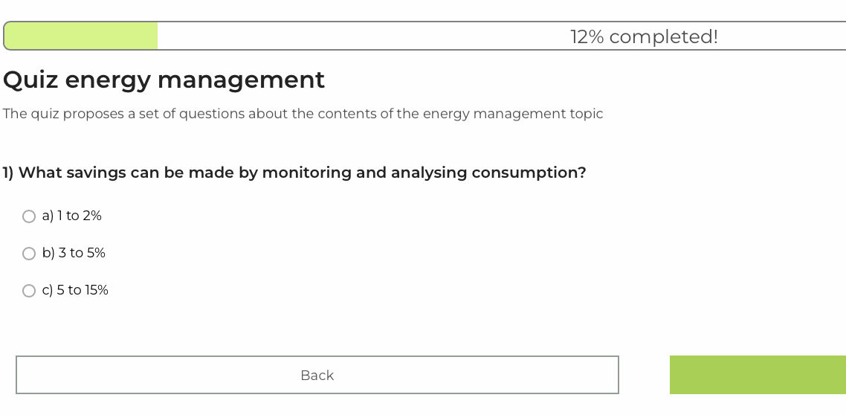
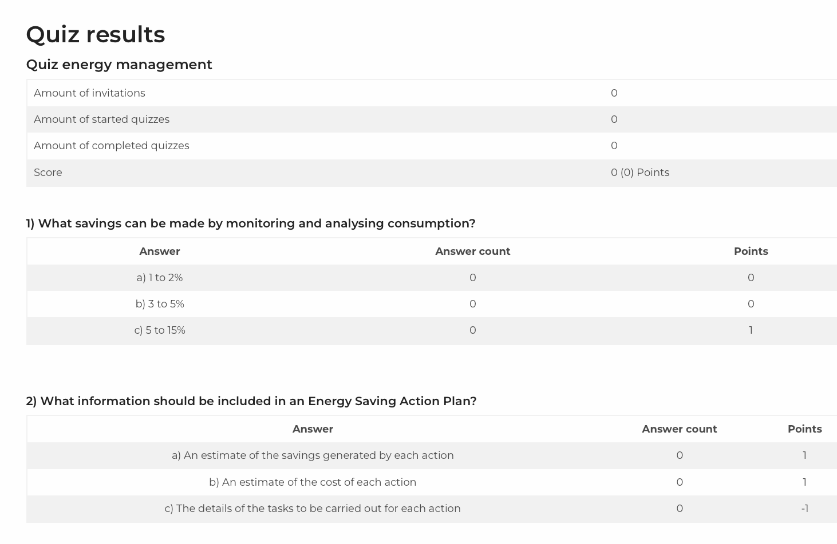
EnergyEfficiency4SMEs
Co-Funded by the European Union
How does Impawatt work – Quiz Section and collaboration possibilities
Invitation of additional users (e.g. energy
advisers, technicians, CEO) to
account
Invitation of employees to quizzes and
surveys
Evaluation

Slide 83




EnergyEfficiency4SMEs
Co-Funded by the European Union
Impawatt is being further developed
Further development within Life projects
Continuous update
Extension to other countries
EE4HORECA: Value Chain Approach
EcoSMEnergy: Energy Intensive Industries
Upload of new training material, like presentations, best practices and evaluation tools developed within Life projects EE4HORECA and EcoSMEnergy.
Regular update of national funding opportunities
Presented to the national and regional Chambers of Industry and Commerce in Turkey to be used in energy efficiency trainings targeting SMEs.
Presented to a delegation of the ministry of industry of Peru

Slide 84


EnergyEfficiency4SMEs
Co-Funded by the European Union
Impawatt is being further developed
Improved User Experience
Scope 1, 2, 3 emissions
Extended Self-Assessment Tool
Data input and display in two divided sections and furthermore dynamic display of performance indicators
Besides the energy consumption and cost monitoring, CO₂ emissions are also in the focus and displayed as total as well as specific emissions.
Extended by special energy efficiency best practice measures applied in energy intensive industries as soon as list of best practice is available

Slide 85
EnergyEfficiency4SMEs
Co-Funded by the European Union
ENERGY EFFICIENCY IN ACTION:
Equipping SMEs for a Green Transition
KNOWnNEBS project

Slide 86
KNOWnNEBs project The idea and methodology of NON ENERGY BENEFITs 16.10.2025
Integration of non-energy benefits into energy audit practices to accelerate the uptake of recommended measures
FINAL CONFERENCE EE4SMEs (Oct. 16th 2025 / Bruessel)

Slide 87

Project partners
Latvia – Ekodoma Ltd. (project coordinator)
Hungary – The Budapest University of Technology and Economics
Portugal – Institute of Systems and Robotics (ISR)
Spain – ESCAN SL
Austria – e7 Energie Markt Analyse GmbH
Bulgaria – Chamber of Installation specialists in Bulgaria (KAPE)
Poland – Krajowa Agencja Poszanowania Energii S.A.
Greece – Centre for renewable energy resources and saving foundation (CRES)
Italy – SOGESCA
November 2022 – October 2025
FINAL CONFERENCE EE4SMEs (Oct. 16th 2025 / Bruessel)

Slide 88

The idea of the project
Problem – companies are slow in uptake of energy efficiency measures suggested in energy audits
Hypothesis – the rate of uptake of energy efficiency measures will be increased if companies see all the benefits from energy efficiency measures (both energy savings and non-energy benefits)
Our solution – develop a methodology which allows to quantify non-energy benefits from energy efficiency measures in companies
FINAL CONFERENCE EE4SMEs (Oct. 16th 2025 / Bruessel)

Slide 89
Company has an old bread baking oven, which uses a lot of energy. Sometimes the oven produces low quality bread, which has to be thrown out and the oven needs 3 people to operate.
Question
Energy is just a small part of the problem
Should we change the bread baking oven?
How can you answer the question, if you address just part of the problem?
Expected answer
Answer they get
YES
NO
You will save 23.5 MWh of energy per year, which is 2056 EUR annual energy savings. Simple payback time by taking into account only energy savings is 18 years
FINAL CONFERENCE EE4SMEs (Oct. 16th 2025 / Bruessel)

Slide 90







Benefits
Efforts
Benefits
Energy
Savings
Benefit 1,
Benefit 2,
Benefit 3,
...
Effort 1,
Effort 2,
Effort 3,
...
Efforts
Investment
Energy
Savings
Investment
Existing
Approach
Methodology
FINAL CONFERENCE EE4SMEs (Oct. 16th 2025 / Bruessel)

Slide 91


Sickness & absenteeism
Avoided mortality
Accuraate monitoring
Risk reduction
Key Domains
Health
Health & well-being
Quality
Disease burden
Increased quality of products
Work performance
Customers
Reduced injuries
Operation safe equipment
Right first time
Social
Reduced maintenance costs
Security & Safety
Improved working conditions
Increased productivity
7 domains
51 NEBs
derived from:
surveys
interviews
evaluations
assessments
Energy security
Time
Employee satisfaction
Reduced time of fault detection
Alleviation of energy poverty
Ecosystem degradation
Waste generation
Less maintenance
Economic
Environment
Macro economy
Material consumption
Improvement of competitiveness
Reduced emission fees
FINAL CONFERENCE EE4SMEs (Oct. 16th 2025 / Bruessel)

Slide 92

What are the impacts of NEBs?

Slide 93

Types of NEIs (NEBs & NEEs)
 | Benfits (NEBs) | Effort (NEE)
Quantifiable
Not quantifiable
FINAL CONFERENCE EE4SMEs (Oct. 16th 2025 / Bruessel)

Slide 94
Types of NEIs
Quantified (monetized) NEIs
NEIs for which we can give more or less exact value (for example – reduced mainenance costs by € 300,-/ a) in monetary terms
Not quantified (not monetized) NEIs
NEIs for which we know that they occur during the suggested energy efficiency measure implementation but we can not give an exact monetary valuation (for example, improved indoor air quality; green image of the company). These NEIs also include NEIs for which we can give exact value but it is not monetary (for example, changing of production line leads to noise reduction by 10 dB)
FINAL CONFERENCE EE4SMEs (Oct. 16th 2025 / Bruessel)

Slide 95

How about the NON Quantifiable NON Energy Benefits
Example:
Less noise, less emission, …..
We do not say or estimate the costs
In order for the EEM to be feasible the value of not quantified yearly NEBs should be at least X.XXX EUR or there should be initial NEBs with value of 8004 EUR (which is 2,7% of CAPEX)
The tool determines a value that must at least be achieved in order to be economically viable.The owner can then decide whether this is worth it to him.
FINAL CONFERENCE EE4SMEs (Oct. 16th 2025 / Bruessel)

Slide 96

Results from KNOWnNEBs
Master methodological approach – Describes the entire process of planning, analyzing, and presenting the outcomes of energy efficiency measures
TOOL1 – Guides the identification of Non-Energy Benefits (NEBs) for planned Energy Efficiency Measures (EEM)
TOOL2 – Evaluates the impact of NEBs and Non-Energy Effects (NEEs), enabling a comprehensive analysis of proposed EEM
Result Presenting approach – Provides a clear, straightforward method to present results to company decision-makers, who may not be familiar with energy savings expressed in MWh
Training materials: Slides, Youtube, Guidebook
8 different languages
https://www.e-sieben.at/en/projects/22003_knownnebs.php

Slide 97






Working with TOOL2
You have to
Input costs of EEM [EUR], savings [MWh per year], energy price [EUR/MWh] – taken from energy audit
Input NEBs and NEEs
The tool will
Calculate and compare economical feasiblity for EEM with and without NEBs
Quantify not quantified NEBs and show the necessary co-financing amount for the EEM to be feasible
Do sensitivity analysis (how changes in assumptions impact the results)
Do scenario analysis (most likely case, best case and worst case)
Do CAPEX analysis (what are the permissible costs of an EEM in order for this EEM to be feasible)
Create a benefit indicator (a single indicator to indicate benefit of a energy efficiency measure)
Summarize multiple (up to 10) EEMs
10 languages
Scenario analysis
CAPEX analysis
Benefit indicator
Sensitivity analysis

Slide 98

Summary
Tool is available free of charge
Download here: https://www.e-sieben.at/en/projects/22003_knownnebs.php
Tool not locked => Customisation / extension / integration of a logo possible
Tool can be used only as a profitability tool.
Tool increases the ‘credibility’ of the consultant if it also records NEEs
Tool support energy managers within the company
Mentioning the negative influences increases credibility
Approach to non-energy benefits requires experience and training
FINAL CONFERENCE EE4SMEs (Oct. 16th 2025 / Bruessel)

Slide 99
Effect of NEBs on energy efficiency measure implementation rate
If NEBs are not considered then only 68% of analysed measures should be implemented
If NEBs are considered then 84% of analysed measures should be implemented

Slide 100



Effect of NEBs
NEBs add around 70-84% of quantifible value to energy efficiency measures
But there is more – the added value of not quantified NEBs

Slide 101
Q&A
FINAL CONFERENCE EE4SMEs (Oct. 16th 2025 / Bruessel)

Slide 102


THANK YOU!
Georg Benke
georg.benke@e-sieben.at

Slide 103
EnergyEfficiency4SMEs
Co-Funded by the European Union
ENERGY EFFICIENCY IN ACTION:
Equipping SMEs for a Green Transition
Empowering SMEs through Improved Policy Assessment and Delivery
Experiences from the LEAP4SME project
Enrico Biele, ENEA

Slide 104


LEAP4SME
Energy Audit policies to drive Energy Efficiency
Main goals
Consortium
The National Energy Agencies of Austria, Croatia, Greece, Italy, Malta, Poland, Portugal, Slovakia, United Kingdom and the Communication partner Revolve
Mapping and understanding the complex context of national and local support to SMEs
Contributing, through LEAP4SME research, analysis, and stakeholders involvement, to help the Institutions finding solutions to fill the gap of data
Knowledge sharing (successes, barriers and failures) on national policies
Proposing effective and realistic solutions to policy makers and policy implementers in terms of policy schemes, cross-cutting policy solutions embracing both energy and non-energy benefits, policy recommendations

Slide 105


1) Pre-assessment
Analysis of 173 policies, programmes, projects covering the nine targeted Countries
Outcomes and preliminary recommendations:
• Further evaluate a combined approach with a mix of different instruments
• Assess the effectiveness of focused obligations for SMEs to conduct energy audits
• Sector specific policy instruments & assessment of tailor made approaches at the intersection of firms size and specific aspects of energy investment
• Create linkages between audits and wider support programmes
Source: LEAP4SME report “Mapping SMEs in Europe: Data collection, analysis and methodologies for estimating energy consumptions at Country levels”. Author: AEA
Energy efficiency in SMEs

Slide 106


2) In-depth assessment
21 policies and programmes analysed in 9 European countries
Quality energy audits appear to be higher in EED policies than in the voluntary programmes
High quality audits are linked to obligatory implementation of Energy Performance Improvement Actions (EPIAs)
Stand-alone audit programmes seem not to have restrictive quality standards
LEAP4SME (2022) , D3.3 Compilation of good practices
Notes:
Moving to the policy assessment 21 policies and programmes have been identified as good practices during the project, categorized in the graph on the left and analysed on a detailed basis.
Each good practice has been assessed focusing on its performance related to six features shown in the radar chart:
quality of the audits, implementation of EPIAs, replicability, multiple benefits, EU or National/local funds and Energy Performance Contracts

Slide 107
3) Stakeholders’ engagement
National and international observatories
network of experts in the field of SMEs energy related aspects
Training
raise awareness and knowhow transfer among regional, national and EU policy makers, implementation bodies, Research Institutions and private sector stakeholders
Surveys and Interviews
through two surveys, the opinions from a wide range of Organisations, experts and SMEs have been collected.
Policy Assessment
collecting, listing and analyzing the good practices on the development of policies for the encouragement of energy audits in SMEs
Energy efficiency in SMEs

Slide 108


3.1) Example of Stakeholders engagement: National Observatories
30 Meetings - more than 750 participants in 9 countries
Meetings organized from May 2022 to June 2023 by the 9 Energy Agencies
Energy efficiency in SMEs

Slide 109


4.1) Comparing data & behavioural issues
Case study: focus on the Plastics sector in Italy
LEAP4SME Behavioural reserach
Having a monitoring system positively affects energy saving per site, EPIAs and company
The use of EnMS increases savings (in % of total consumption)
Higher savings in energy intensive SMEs
EST has conducted a REA and a set of high-level interviews on the influence of decision making in SMEs and behavioural-related issues

Slide 110

4.2) Assessing policy options
Source: LEAP4SME Survey results and EED Recast Consilium Interinstitutional File: 2021/0203(COD), 24/3/23

Slide 111





4.3) Policy uptake within the Consortium Agencies: two examples
Through LEAP4SME assessments, the Agency identified some energy consuming NACE categories to as priorities to launch, in February 2022, the national pilot project MERCA (Managing Essential Resources in Retail through Consumption Analysis) focusing on small and medium retail establishments that sell food and beverages.
CRES used LEAP4SME results in order to provide support to the Ministry of Environment and Energy and/or the Regional authorities of the country which request support in the policy implementation directly related to the Energy Efficiency Directive transposition, as well as for providing support to them for policy planning and reporting.

Slide 112




4.4) LEAP4SME policy uptake beyond the Consortium
Invitalia, Italian National Agency for Inward Investment and Economic Development
TTJA, Consumer Protection and Technical Regulatory Authority of Estonia

Slide 113



5) Policy recommendations
Energy efficiency in SMEs

Slide 114
EnergyEfficiency4SMEs
Co-Funded by the European Union
Thanks for your attention
Contact:
Enrico Biele
enrico.biele@enea.it

Slide 115
EnergyEfficiency4SMEs
Co-Funded by the European Union
Closing remarks and acknowledgements

Slide 116























EnergyEfficiency4SMEs
Project partners
Co-Funded by the European Union

